Slide 1
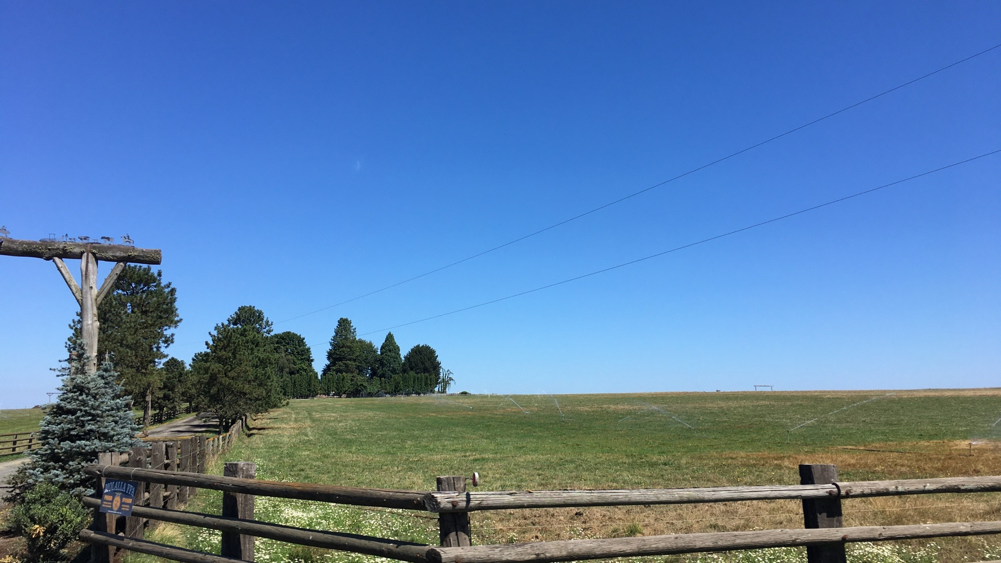


ECONOMIC VITALITY (EV) ROADMAP
City of Molalla
June 9, 2021

Slide 2
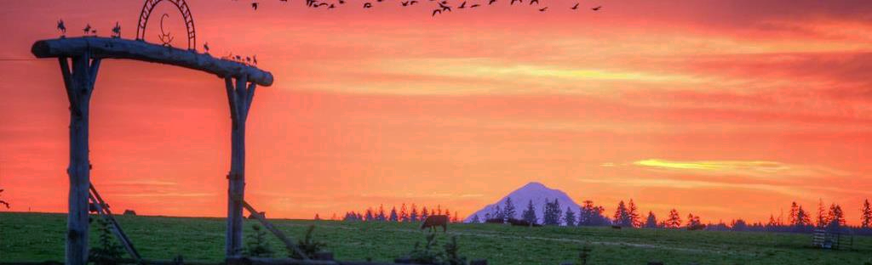
VISION PLAN: 5 FOCUS AREAS
5 Focus Areas based on City aspirations for 2030:
  A resilient community that passionately recognizes and builds on its history, culture, and location
  A welcoming, friendly and vibrant community with an attractive hometown feel that is safe, hospitable, and inclusive of all residents, businesses, and visitors
  An economically sound and growing community which is evident in the diversity of businesses, partnerships, education, innovation, and the strong work ethic of its people
  A full-service hub of resources
  A beautiful and tranquil area where people are deeply connected to its unique natural features

Slide 3
THE MOLALLA ECONOMIC DEVELOPMENT COMMITTEE
PURPOSE: To assist with the creation of a tangible economic development action plan and encourage community engagement in implementation
    Pamela Lucht - NW Transplants LLC
    Elizabeth (Lizz) Klein – City Council
    Crystal Robles - City Council
    Brad Berzinski - Molalla High School
    Robert Thompson - Welcome to Molalla & eXp Realty LLC
    Mac Corthell - City Planning Director
Guided by a Community-based Process

Slide 4
PRIORITIES FOR ACTION – 2021
Create and implement an Appealing, Cohesive, Community Identity/Brand
1
Advocate for Small Business Development
2
Improve Downtown Curb Appeal: from clean up and painting to landscaping, banners, lighting.
3
Create an Economic Development Roadmap to improve economic vitality and to grow resources and community services. City will lead.
4
“Develop a beautiful historic downtown area with thriving small businesses.”
“I want to see an inviting downtown area.”
“A cohesive sense of community, business and property owners in the downtown core that take
pride in their downtown.”
LatineX Action Team
Interwoven elements of Community & Economic Vitality
Source: Molalla Vision Plan
Notes:
Molalla's Economic Vitality Roadmap provides an overview of the local economy, identifies assets and opportunities for growth, and focuses on key initiatives to improve commerce and community livability in the next 3+ years

Slide 5
Story Walk Storyboards are underway
Clean-up Day planning
Organized Advocacy for Highway improvements
Small Business Outreach & Survey Completed
Engagement of LatineX residents
Draft Molalla Identity & Market Position Statement
Flower baskets/planter program underway
Engaged and committed Steering Committee meeting monthly
Sample
of Results:
Nearly 40 community members are engaged with moving Molalla’s Vision Plan to Action!

Slide 6
Molalla Visioning (2019)
Industry Cluster Analysis (2020)
Vision-to-Action Teams underway (2021)
Demographic Snapshot (2021)
THE EV ROADMAP BUILDS ON:
Molalla's Economic Vitality Roadmap provides an overview of the local economy, identifies assets and opportunities for growth, and focuses on key initiatives to improve commerce and community livability in the next 3+ years

Slide 7
WHAT MAKES AN ECONOMIC BASE?
Agriculture
Construction
Government &
Education
Exported Goods & Services
Tourism, Hospitality
Manufacturing (e.g., Metals, Wood)
Commercial
Retirees
“It’s not one thing!”

Slide 8
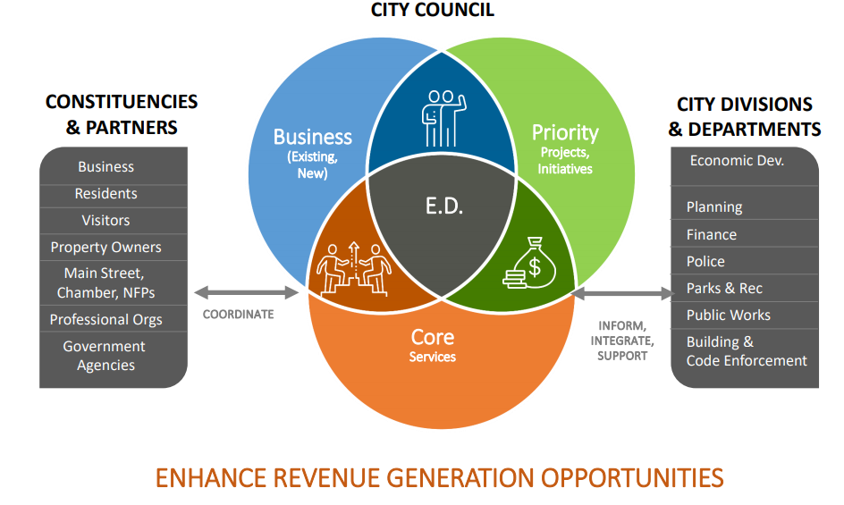
Many Economic Development Roles

Slide 9
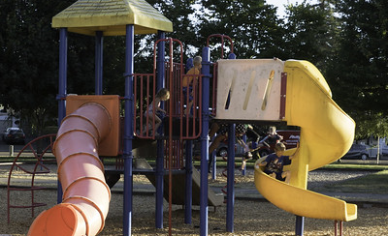
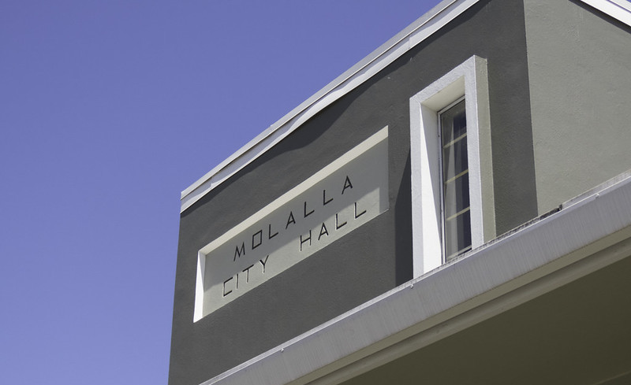
In this work, stay focused on:
BUSINESS INTERESTS & RESOURCES
Workforce – Talent, Education
Competitive Business Costs
Market (access, consumer base)
Quality of Life
Government/Regulation (positive)
Real Estate
Incentives, Financing, Capital
Housing

Slide 10
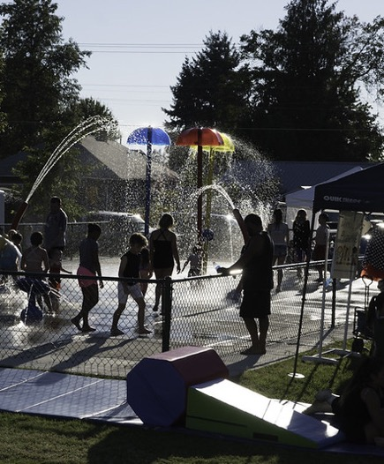
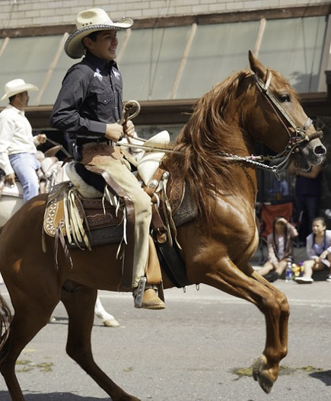
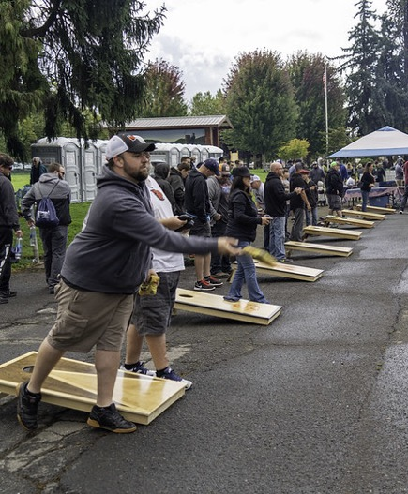
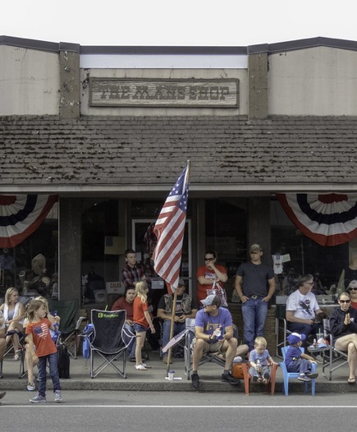
OUR COMMUNITY is Growing and Changing
Assessment and Next Steps Highlights…….

Slide 11
GROWTH TRENDS: Building Permits Issued
2020
Residential | 32
Commercial | 4
Industrial | 0
2019
Residential | 64
Commercial | 4
Industrial | 0
2018
Residential | 152*
Commercial | 1
Industrial | 1
In May 2021, 16 commercial & industrial projects are active.
*includes Bear Creek

Slide 12
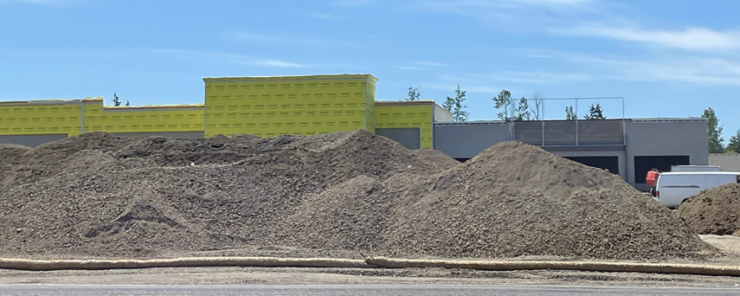
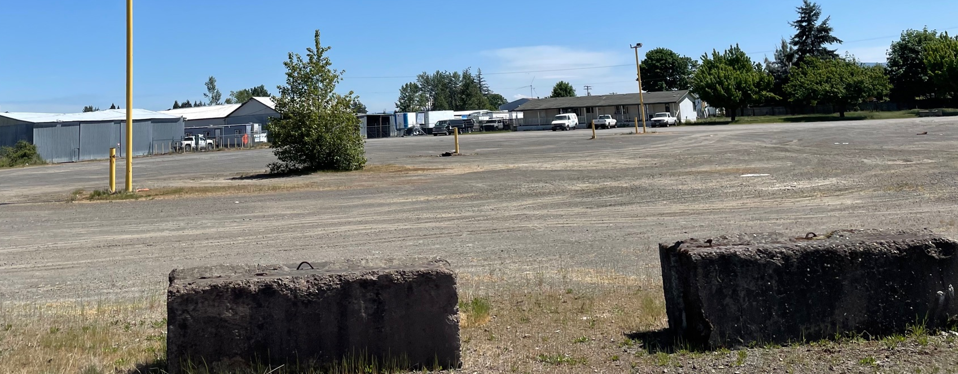
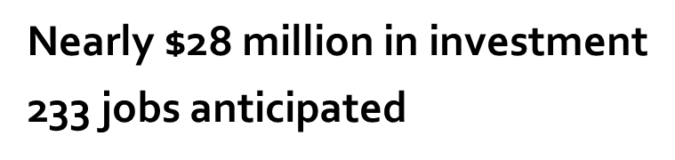
As of May 2021, 16 active projects in pipeline:
12 commercial & 4 industrial
Self Storage - Cascade Center
Autozone - Cascade Center
Grocery Outlet - Cascade Center
Dollar Tree - Cascade Center
Goodwill - Cascade Center
Burger King - Cascade Center
Dollar General - Cascade Center
Dairy Queen
Dansons
Molalla Market Place Bank
Molalla Market Place Retail
Scandia
Center Market
B & I Construction and Office Space
Industrial Landscaping Company
Industrial Landscaping Company Retail Space
Mobile Food Unit Pod
By Design Steel Company
Notes:
Success attracts success

Slide 13
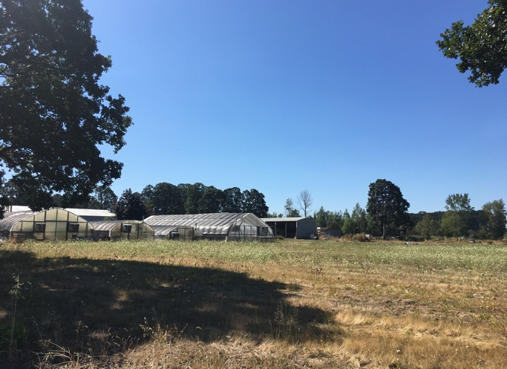
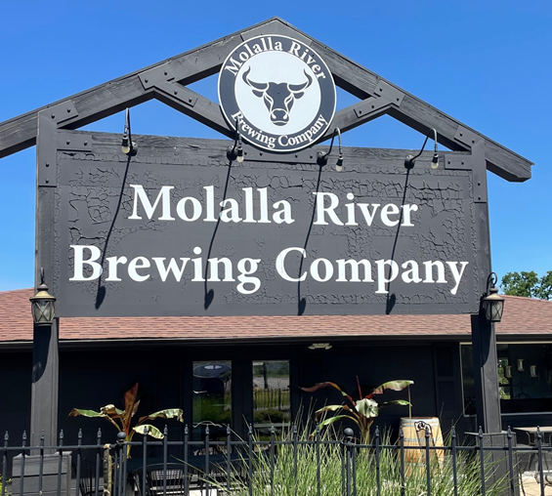
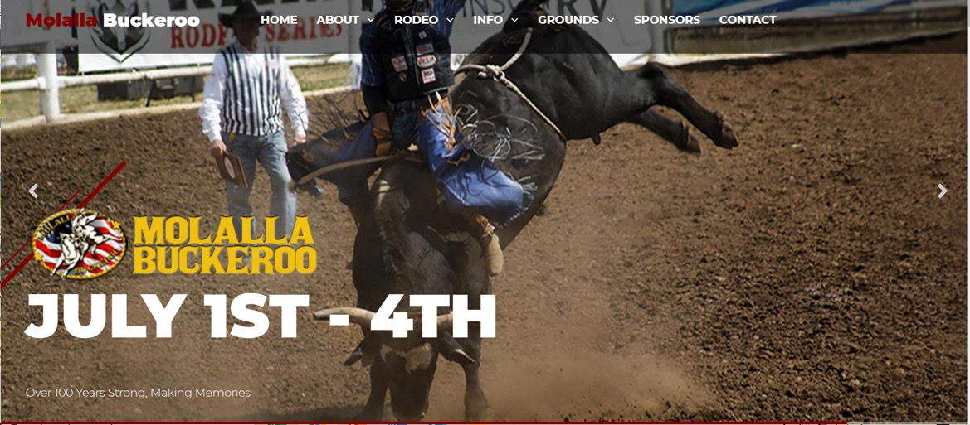
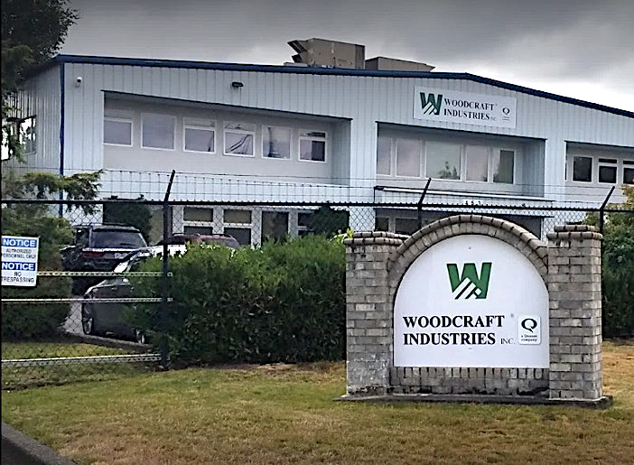
ECONOMIC DIVERSITY IS A KEY ASSET
3200 local jobs - From agriculture and manufacturing to tourism and retail

Slide 14
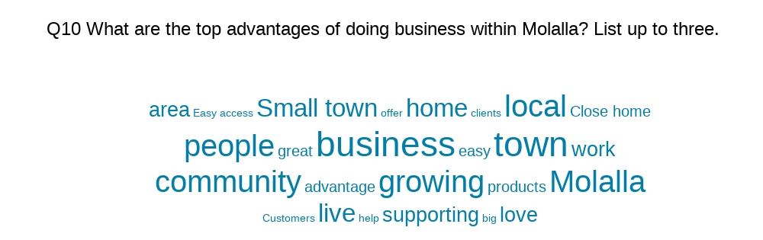
WHAT LOCAL BUSINESSES ARE SAYING…
Molalla’s Small Business Advocacy Action Team created a Small Business Survey, garnering 35 responses from local business owners and/or operators in March 2021. What follows are a few key highlights from results.
Business owners are generally optimistic despite a tumultuous 2020 – with most saying they either will expand or stay steady
When asked about the top advantages of doing business in Molalla, an overwhelming majority pointed to the small town feel and local community
Notes:
Help Wanted– skilled labor and property / space for expansion

Slide 15


BUSINESS CLIMATE SUMMARY
ASSETS | CHALLENGES
Well-rated high school Community feel, neighborly support Natural beauty and resources Economic diversity | The availability and skill level of workforce Ability to navigate and keep up with the tax laws and government regulation Limited land availability Market support/shoppers Downtown parking is limited Limited roads in and out of town
Source: Molalla Small Business Survey

Slide 16
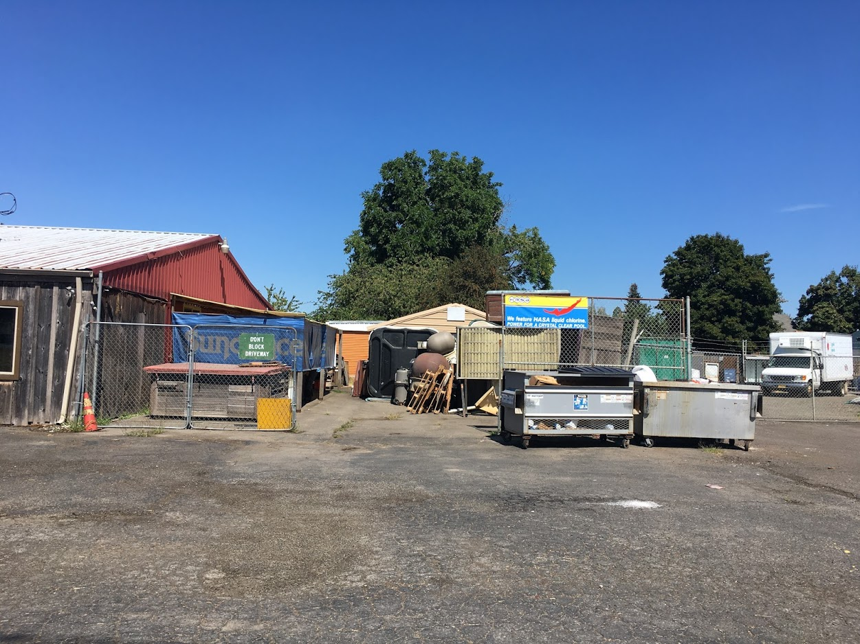
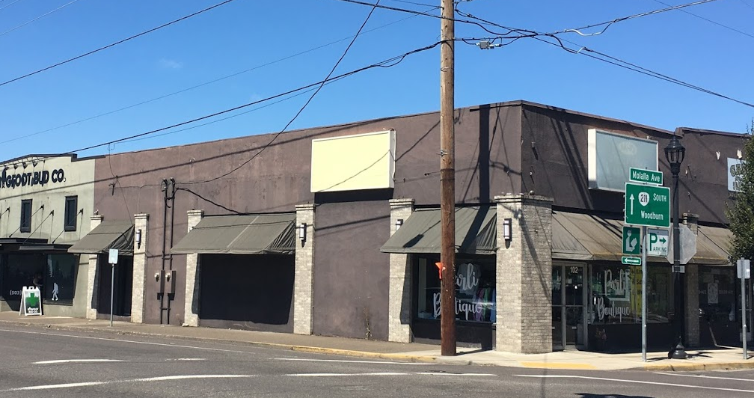
CHALLENGES
“There are way too many vacant buildings and small businesses have a hard time. Something needs to be done to help small businesses and encourage property owners to maintain their buildings and work with renters.”
“We really need another store out here. I shop Winco, Trader Joe’s and Costco because Safeway is always understaffed and overpriced. Maybe a lower priced store would keep people local for shopping!”

Slide 17
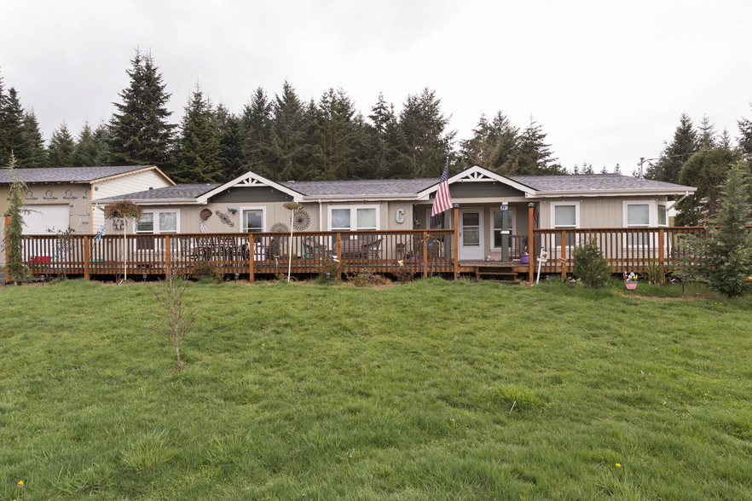
Available Industrial Space exists but is limited and little is ‘on the market’
Only 1 Industrial space actively marketed (spring 2021)
Molalla Forest Road Industrial Park
17,800 SF building on 14.55 AC lot
Undeveloped; but What’s Buildable?
Vacant Heavy Industrial (M-2)
Within UGB: 128.99 ac
Vacant Light Industrial (M-1)
In UGB: 13.41 ac
Sources: Loopnet, City of Molalla
Notes:
https://www.loopnet.com/Listing/13388-S-Molalla-Forest-Rd-Molalla-OR/17710607/

Slide 18
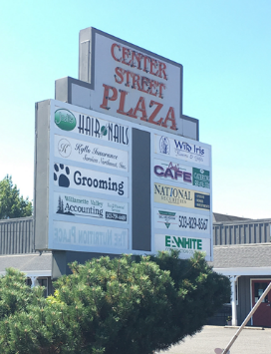
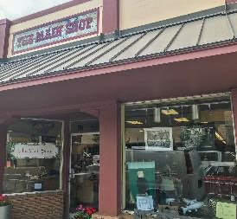
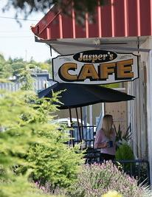
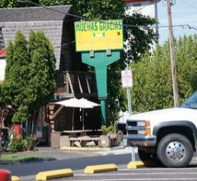
Retail Business Development
OPPORTUNITIES
Quality of Life Improvements
Fill vacant business spaces; Expand retail base
Marketing campaigns
Home prices
Schools
Recreation
Crime
CLOSED
“Bring back a vital Main Street to the heart of town -- a bustling 'old-town,' busy with hometown business, like it once was.”
Tourism Development
“More grocery stores!”
“More shopping and food options.”
Industry Cluster Expansion

Slide 19
Economic Development Core Services
How to: Grow the Economy?
Build Your ED Network & Synergies
Business Assistance & Facilitation
Business Attraction & Marketing
Entrepreneurial Development
Economic Snapshots & Benchmarks
Branding
Marketing (e.g., website)

Slide 20
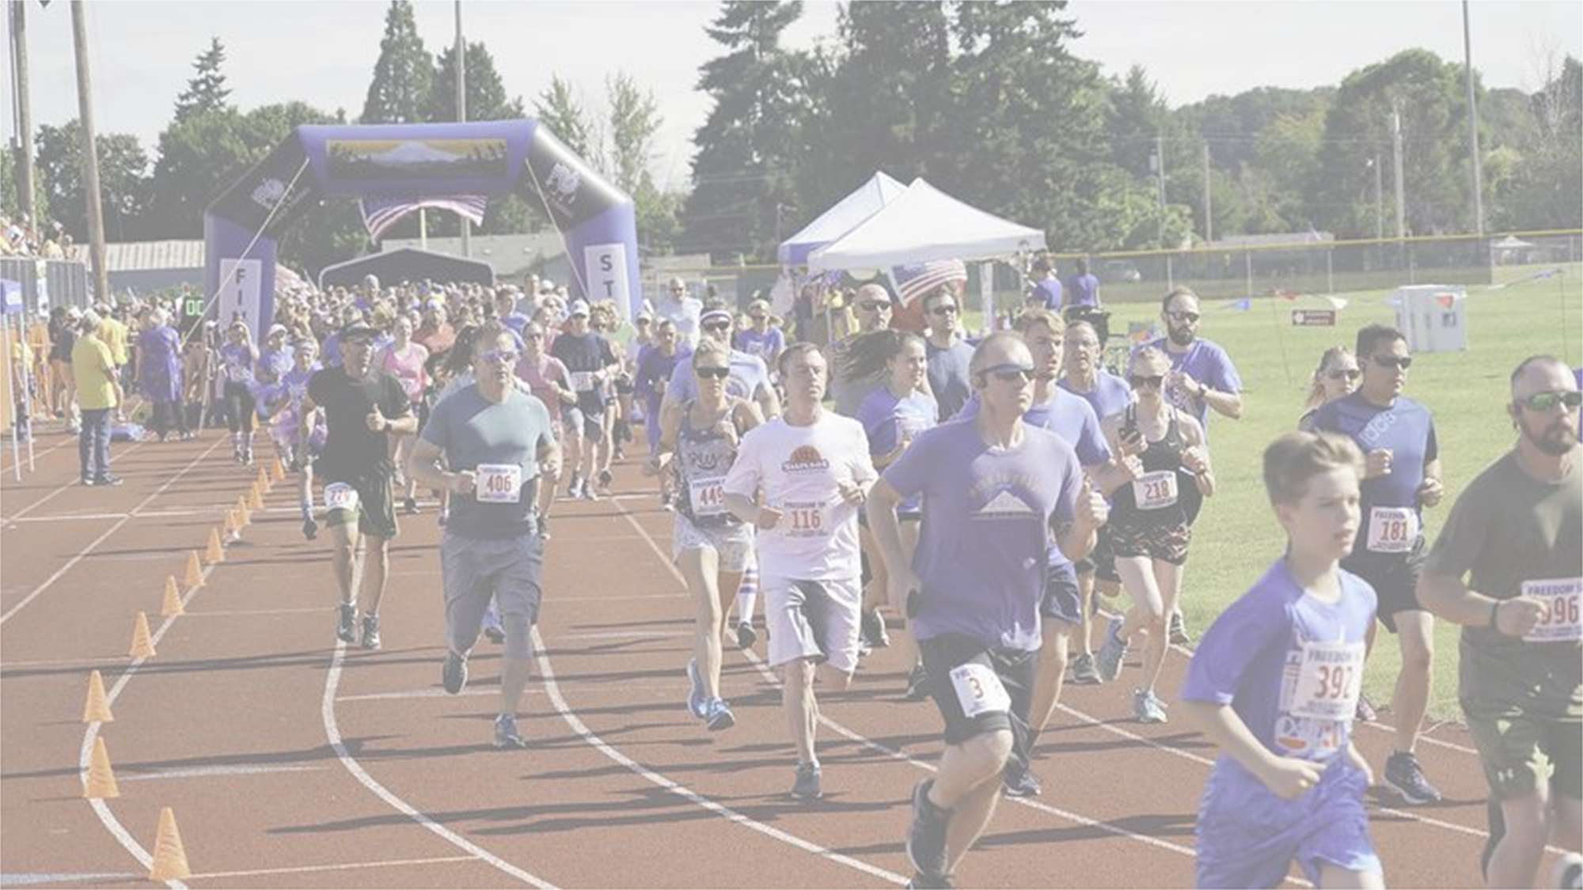
To Compete….

Slide 21
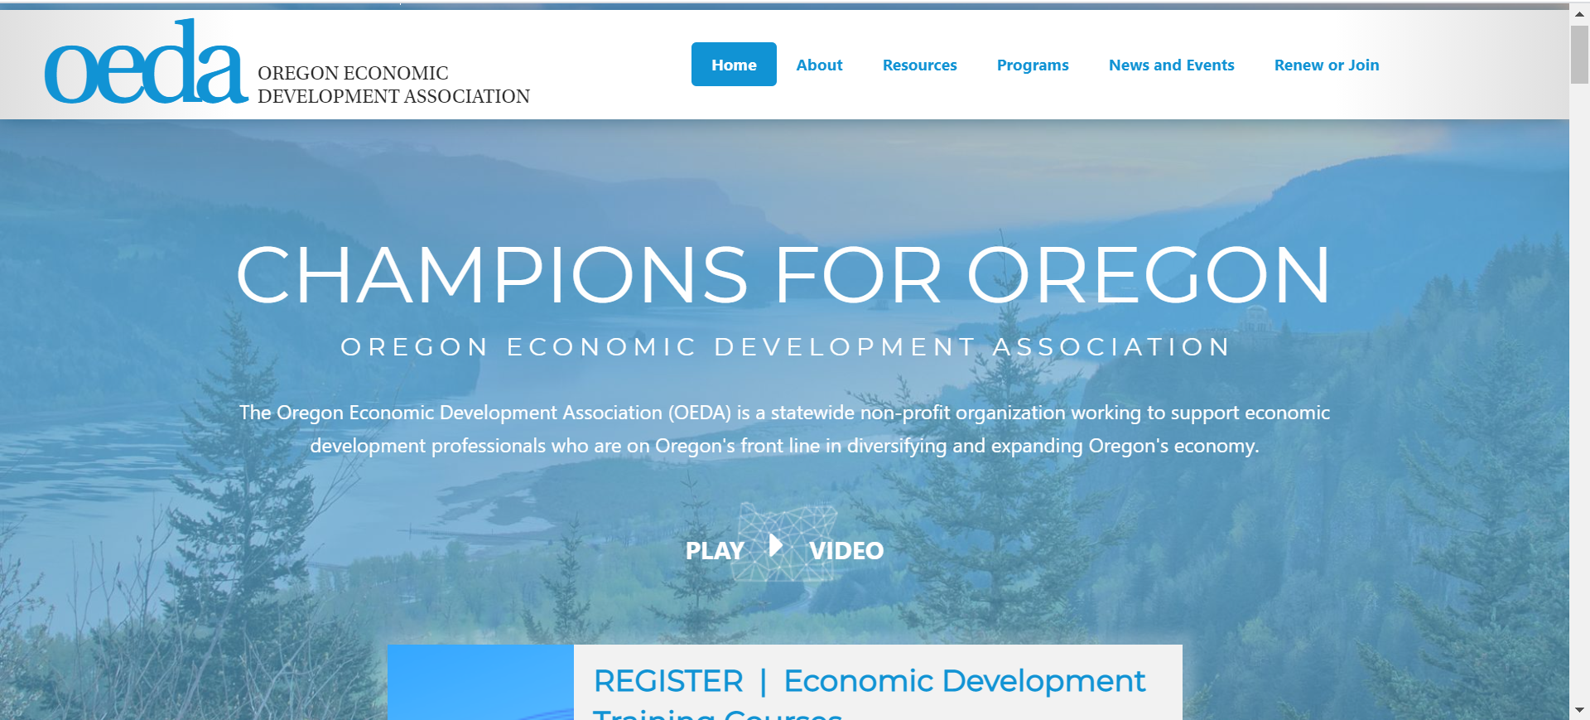
1. Get active within the economic development profession.
Notes:
OEDA has 151 member organizations/communities and ~400 individuals associated with those entities that actively engage with OEDA. Most of those individuals are the EcDev staff at those organizations, but perhaps only 20% of the members orgs are EDOs, most are communities and municipal governments.

Slide 22
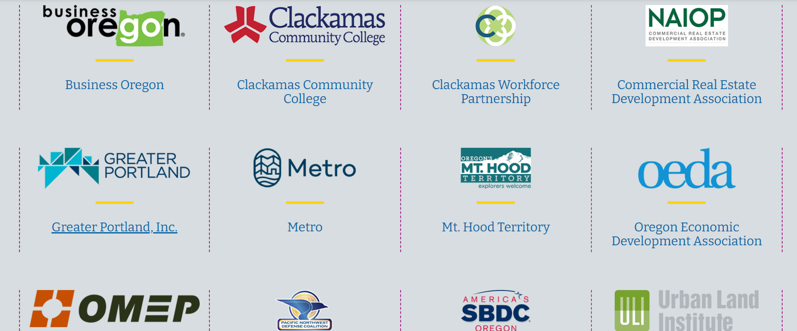
2. Tap Economic Development Partners and Resources(many!)

Slide 23
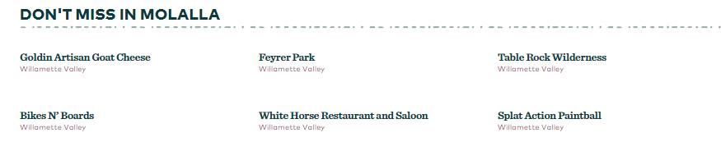
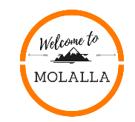
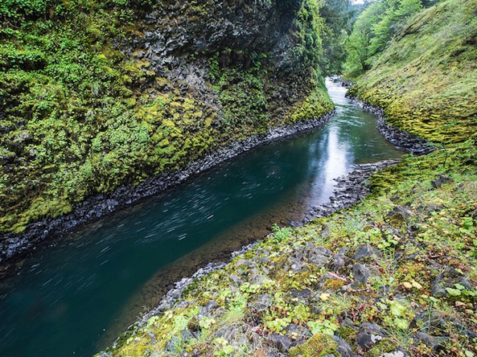
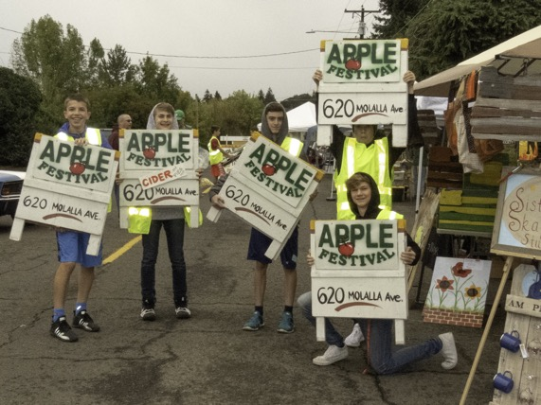
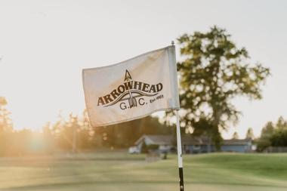
Ex:VISITOR INDUSTRY
3. Tell Your Story – Promote Your Successes!
Travel Oregon Molalla page features Molalla Train Park, the Buckeroo and Rosse Posse Acres Elk Farm
There are opportunities to draw more visitors in to Molalla. Key to success = Partner with key attraction and visitor industry leaders in and around the area to increase Molalla’s market exposure.
Welcome to Molalla page has space for upcoming events and offers a comprehensive spot for visitors to see businesses and restaurants. Continue to build on the momentum on that page!

Slide 24
….……Investment is a must
4. Get a clear picture of your real estate: commercial and industrial and how to expand ‘market-ready’ properties.
Staff. Marketing and Visibility. Planning for continued economic growth.

Slide 25

2021 – 2022 FY Workplan
Strategy 1 | Support and guide the Economic Development Steering Committee(SC) and Action Teams
Strategy 2 | Encourage and support formation of Latinx Action Team
Strategy 3 | Strengthen partnerships with and leverage resources of economic and business development organizations to serve Molalla business community
Strategy 4 | Meet 1-on-1 with Molalla's largest employers (starting w/ traded sector) to build relationship and understand and help address key challenges and opportunities
Strategy 5 | Follow-up with small business survey respondents
Strategy 6 | Help new and expanding commercial/industrial businesses offset cost of infrastructure improvements
Strategy 7 | Promote City's commitment to economic development and provide businesses 1-stop info center by adding economic development webpage to website
Strategy 8 | For Visitor Marketing, clarify organizational roles and responsibilities of City, Ec Dev Steering Committee, Welcome to Molalla and Chamber + next steps
Strategy 9 | Increase positive media coverage of Molalla's accomplishments, events, community spirit
Notes:
Note: This City staff workplan reflects capacity and resources available as of May 2021. A separate document details specific actions and a timeline for accomplishing.

