Slide 1
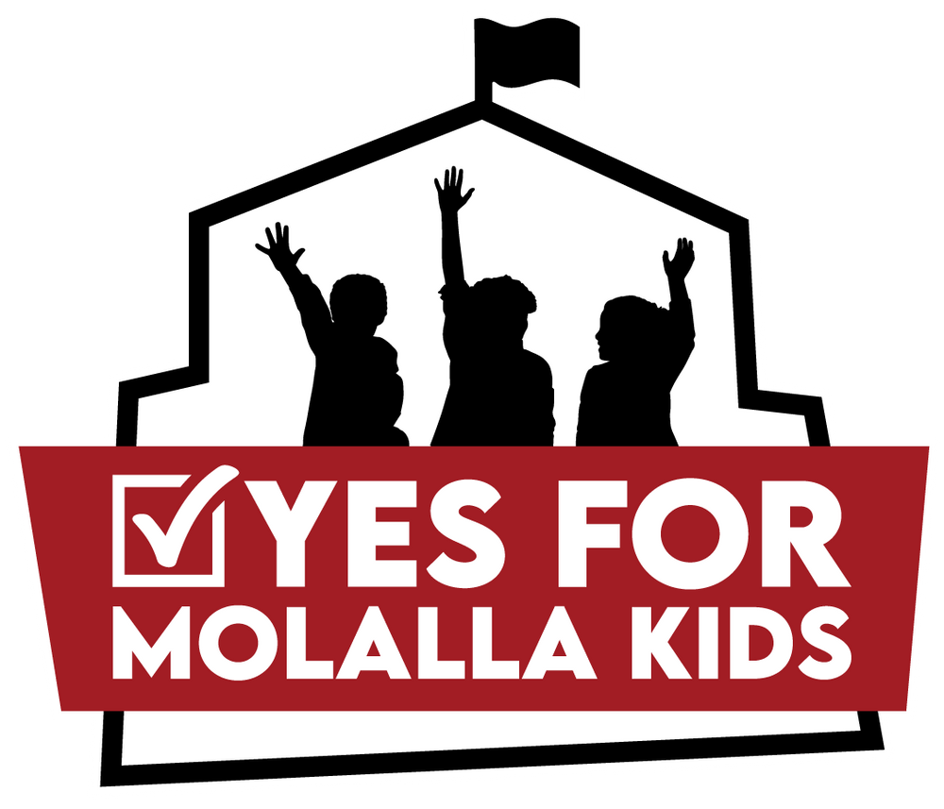
www.YesForMolallaKids.com
Notes:
Good Evening Mayor and City Councilors, thank you for allowing us this time to speak with you.
My name is Kattie Riggs and I live in unincorporated Clackamas County.
Hello, my name is Roxie Smith and I live inside Molalla City limits.
We are here on behalf of the YES for Molalla KIDS Political Action Committee (PAC). We are not from the Molalla River School District, we are not employees or consultants. We are district community members, just like you, volunteering our time to advocate for a new middle school.
The Molalla River School Board voted unanimously to place a Bond request (measure 3-606) on the May 21st ballot. Asking the Molalla community to support the rebuild of the Molalla River Middle School.

Slide 2
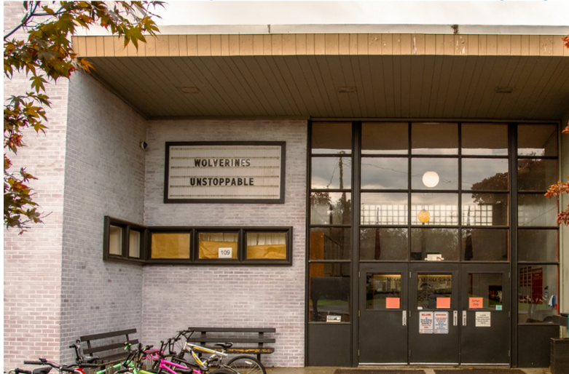
Notes:
This is not a new request and hopefully this is not the first time you are hearing of this. The Molalla River Middle School is over 70 years old (1954) and the community has been trying to ask voters for support to rebuild it for the last decade.
Over the last three years, the school district has completed a comprehensive examination of all the school district’s facilities.
In the last year, there has been a Community Bond Advisory Committee (CBAC), with about 30 volunteer community members that have spent countless hours touring the facilities, examining data, hearing from consultants, discussing the pros and cons to fixing the current middle school as a opposed to building a new one, looking at various location options, and multiple meetings with the Bond consultants to look at the dollar and cents that it would cost the district and taxpayers. There have been several community listening and learning sessions, along with multiple other ways for citizens to provide feedback and input. The community was asked for what the shared vision was for a new middle school.
The CBAC used all of the data and feedback to provide the Molalla River School Board with a recommendation.

Slide 3
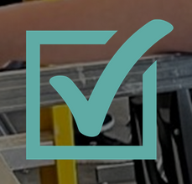
The Proposal -Measure 3-606
Caption: Bonds replacing Molalla River Middle School, improving safety, classrooms, education
Question: Shall district replace Molalla Middle School, improving school safety, learning spaces, removing hazards; issue $77.46 million in bonds; audits required?
Notes:
Out of all that work we arrived at Measure 3-606. This bond is focused on one thing - Rebuilding the Middle School. After countless meetings and thousands of hours from community volunteers providing input and feedback the Molalla River School District has worked with professionals to come up with the ask of $77 million to rebuild the middle school on the current site and adding capacity for up to 700 students. The School Board went with the recommendation from the Community Bond Advisory Committee that chose an option that was not only fiscally responsible, but also forward thinking so that once the school was built it would not already be too small and need to be bigger. The capacity should allow for Molalla’s growth over the next 20 - 30 years with the options to expand in the future, if ever needed.

Slide 4
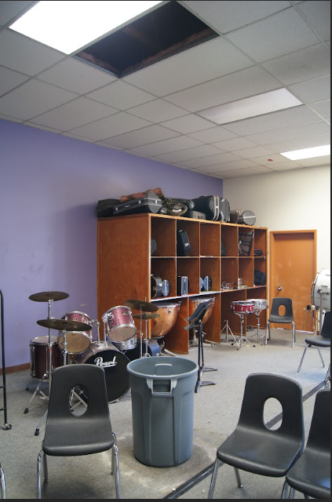
WHY REBUILD THE MIDDLE SCHOOL?
Current Middle School is Failing – in need of critical repairs
Serious Security Concerns
Lack of learning space - overcrowded
Notes:
With all the work that has been completed over the last several years, it was clear that all the facilities in the district needed something, but the middle school is by far the worst.
The 1954-built middle school is failing our kids. Asbestos, extreme classroom temperatures, burst pipes raining water into classrooms, serious security concerns, lack of learning space…the list goes on and on.

Slide 5
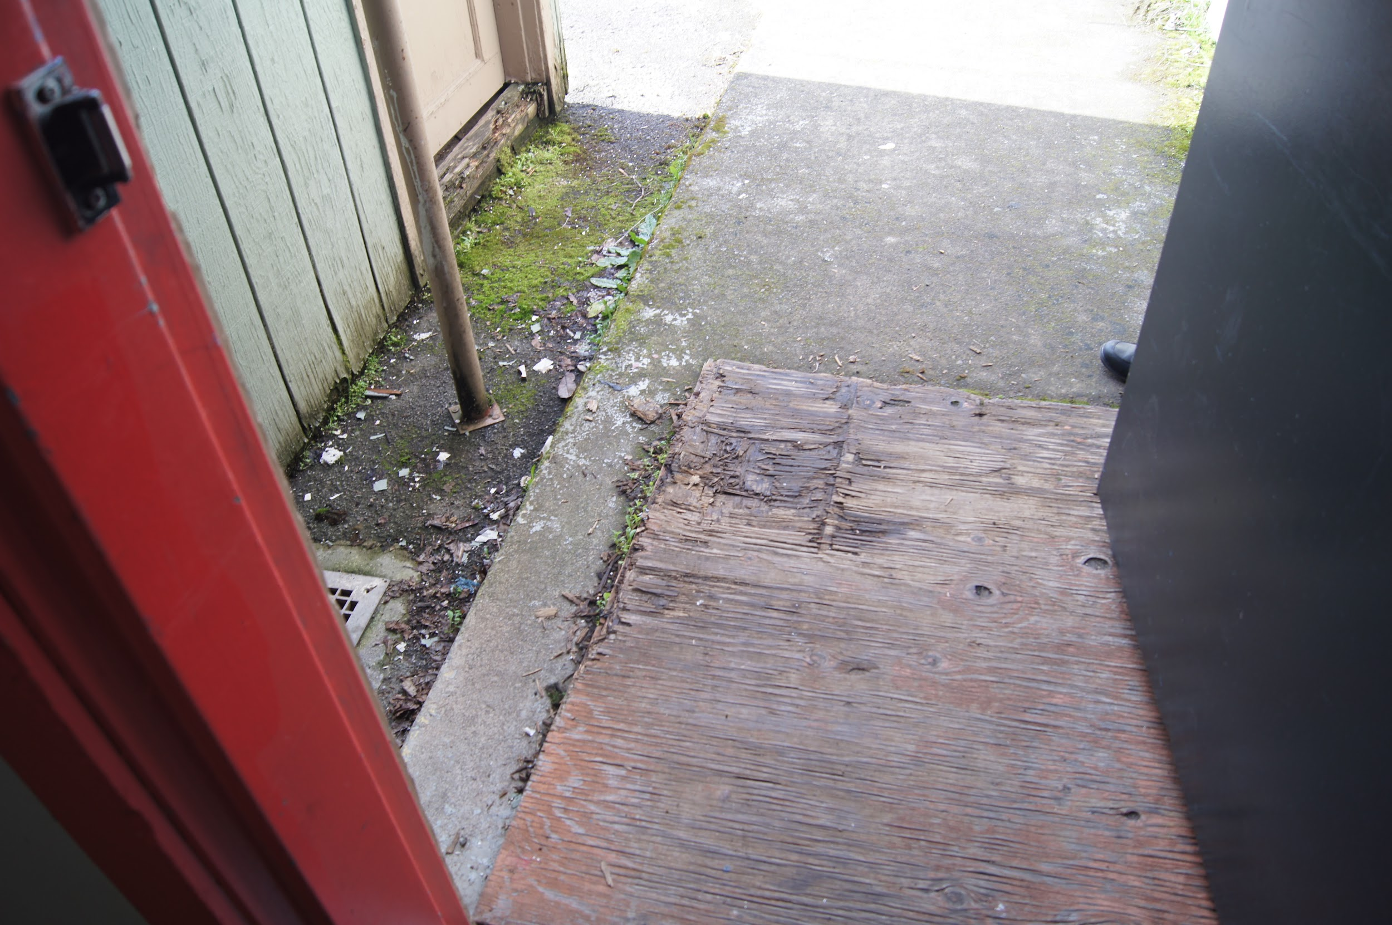
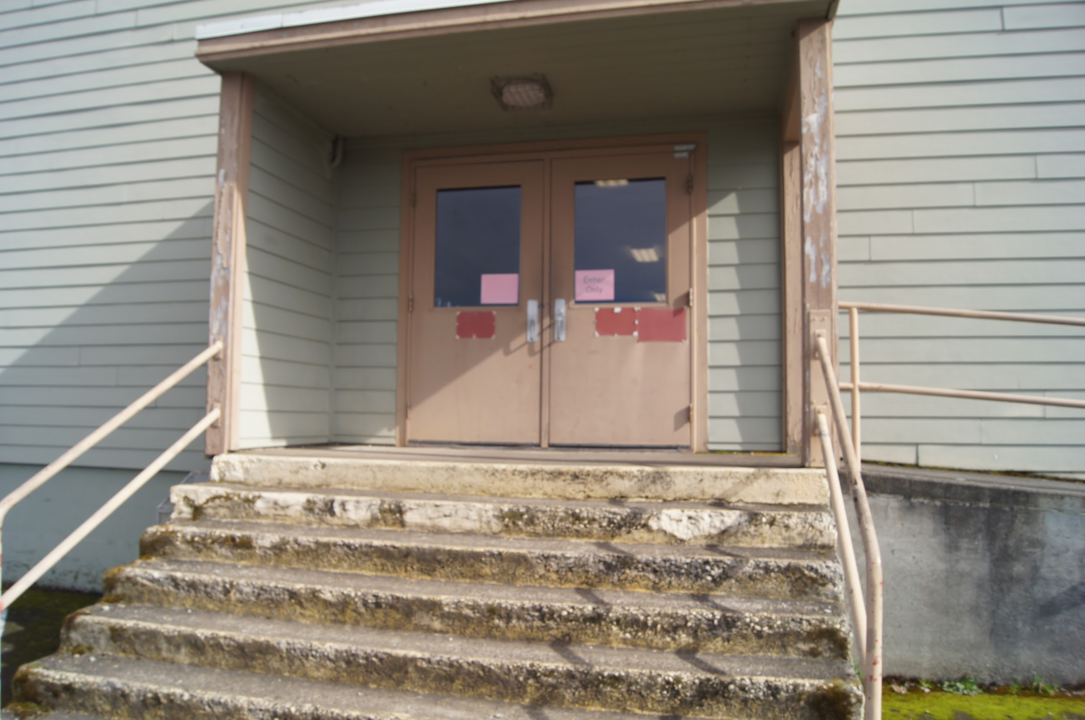
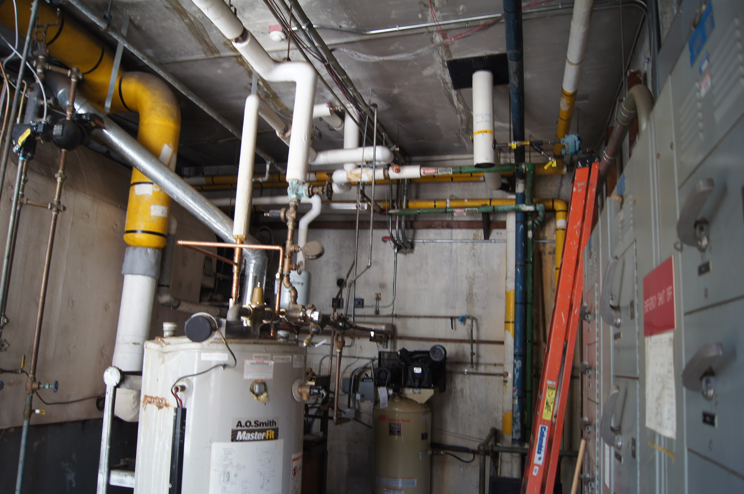
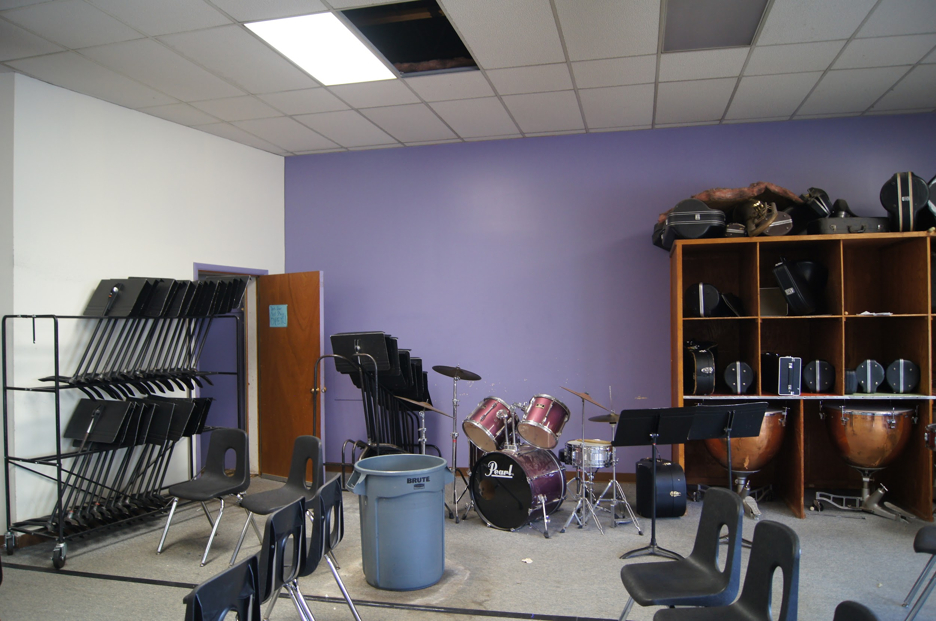
Notes:
Our school district works hard to provide an excellent education for every student and to maintain all of their facilities. Unfortunately, Molalla River Middle School, is a failing building that is having a direct impact on student learning: Three years ago children had to attend school with no heat or water in the middle of winter and just a few months ago there was no school for two days because of a critical failure with the steam heating system that caused boiling hot water to be raining from the ceiling.

Slide 6
WHAT WILL A NEW MIDDLE SCHOOL MEAN FOR MOLALLA KIDS?
Rebuild Molalla River Middle School on same site
New construction on north side of Middle School property
Rebuild to serve 700 students
2022-2023 Middle School enrollment is approximately 540 students; rebuild would allow for growth of 160 students
115,000 square foot school rebuild includes:
One learning neighborhood per grade level (6th, 7th, and 8th grades – 3 total)
Life Skills and Behavioral Program Support
Support for multiple Career Technical Education (CTE) pathways
Black Box Theatre for Drama/Media Production
Music and Choir Rooms with shared practice/ensemble
Main Gym (2 courts) suitable for full student body assemblies, bleacher seating for 700
Auxiliary Gym (1 court)
Secure courtyard, outdoor dining, covered play
3 baseball diamonds
Soccer Field
Irrigation for athletic fields
Drop-off and bus loops and parking
Meets current ADA accessibility requirements, energy code, and fire code
Secure entry and perimeter, security cameras, and communication devices for student safety
Abate hazardous material and demolish existing Middle School buildings
Notes:
The new middle school would mean…
The District has worked extensively with the Wenaha Group - a construction management firm that focuses 100% of it’s work on public works projects, and nearly all of those are K-12. The good news is that using real world bids on other middle school projects in Oregon they were able to reduce the total cost of construction from earlier estimates. We understand that for Molalla Voters this is a big ask so we want to be transparent as possible with planned expenditures. If you would like to see the estimated breakdown of the costs associated with the $77 million dollar project we highly encourage you to talk with the District, they would be happy to answer any of those questions.

Slide 7
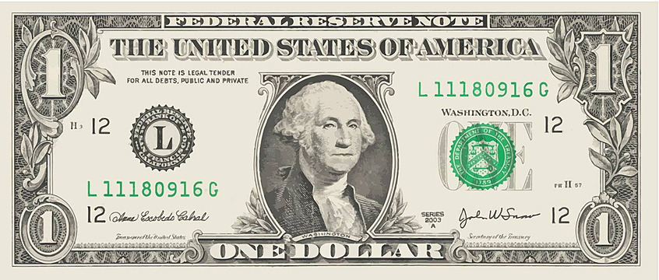
WHAT’S THE COST?
$77 million General Obligation Bond
Rebuild on the same site as the current middle school, but adding capacity
$1.55 per $1,000 of assessed value
Molalla’s average assessed value for homes is around $200,000 which would be an estimate of $36 per month
Notes:
The ask of voter’s and taxpayers is a increase of $1.55 per $1,000 of Assessed value, which would be about $36 per month for the average homeowner in the Molalla River School District (which is greater than the City limits of Molalla.

Slide 8
THREE KEY REASONS TO VOTE YES
A Safe, Secure and Healthier School
Better Opportunities for Our Kids
Right Fit, Right Time for Molalla
Notes:
We have a chance to do something about our failing middle school. Measure 3-606 will replace the failing Middle School with a new, functioning school that the whole community can be proud of. It addresses critical repair needs to protect the security, health, and safety of Molalla’s students and staff. It will also improve our economy, updating our schools to enhance our property values and make Molalla a better place to live, work and raise a family.
There are 3 key reasons to vote yes: 1. A Safe, Secure and Healthier School, 2. Better Opportunities for our Kids, and Right fit, Right Time for Molalla

Slide 9
WHAT IS THE ASK?
Volunteer
Endorse
Donate
Vote
Notes:
NOW, what are we asking of you… We would love to have the full support of the Molalla Community and would ask to please get involved and volunteer. As you know, there is a lot of work to get done in a very short amount of time.
We are collecting endorsements from those who are supportive.
Also, a great campaign can not do the work that needs to get down to educate the voters without funding, we have an extensive strategic campaign plan that will cost us about $37,000 and we have raise about $4,000 to date, so we are looking for donations and trying to do fundraisers.
And last, but not least, we are asking the Molalla community to vote… and to vote yes on measure 3-606 this May!

Slide 10
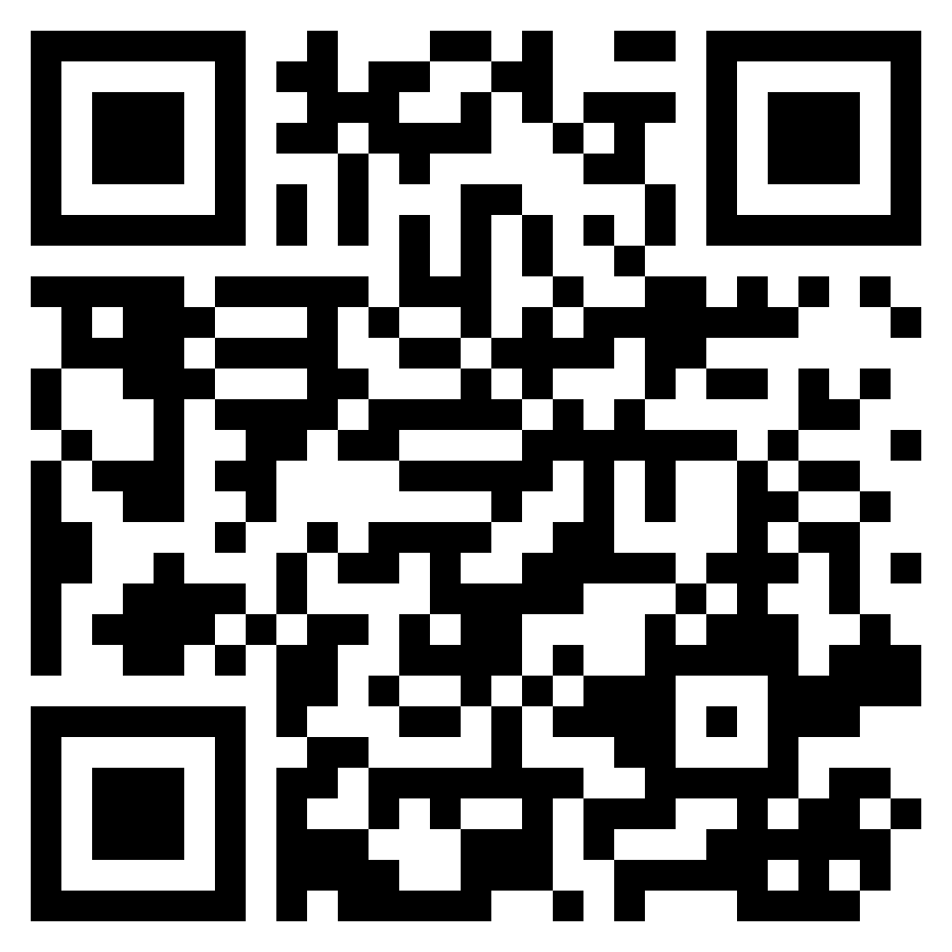
THANK YOU
info@YesForMolallaKids.com
www.YesForMolallaKids.com
Notes:
Do you have any questions for us?

