Slide 1
Molalla
Public
Library

Slide 2
2022-2023
Year-at-a-glance

Slide 3
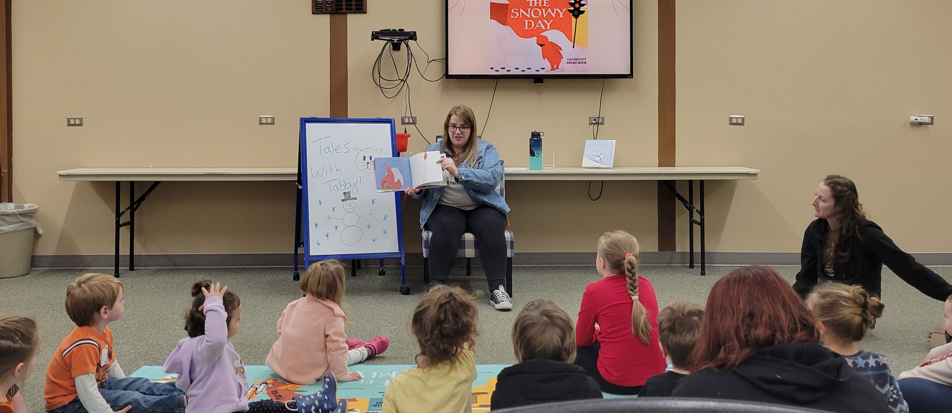
Early Childhood
Increased attendance at storytime and Children’s programming!

Slide 4
Teen
Experiences
Robots, 3-D Pens, Manga art classes, and more!

Slide 5
Adult
Events
Monthly crafts, Mexican cooking classes, and special events!

Slide 6
Outreach Services
Taking the library out into the community!
Los Robles
Bookmobile
Celebrate Molalla

Slide 7
Summer Fun!
Record attendance numbers!

Slide 8
Future
Goals
Expand Music in the Park to
5 performers
Relocate Reptile Man to Clark Park
Increase amount of all types of programs and attendance, including one-on-one computer assistance
Increase social media and online awareness
Increase number of bookmobile stops
Open Community Room to the public
Expand Books on Wheels program to reach more homebound patrons

Slide 9
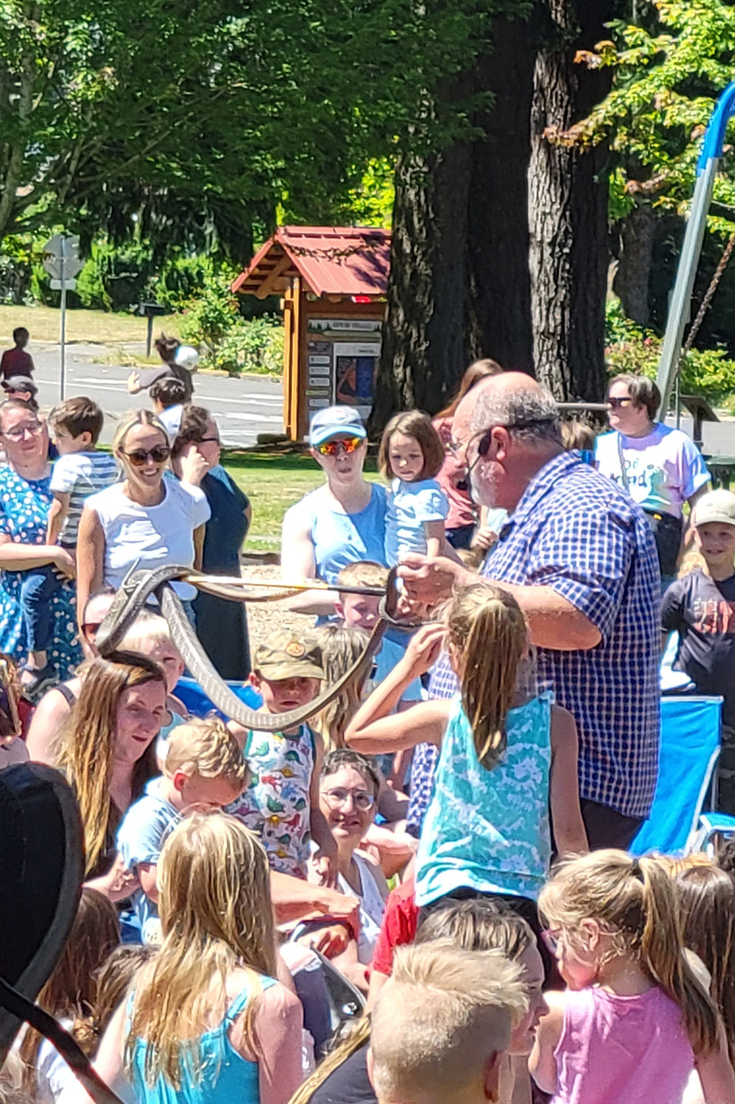
Thank You

