Slide 1
Local government 101

Slide 2
Activity 1: Identifying your city
What is your city?
Where is it located?
What do you like about your city?
Draw the city that you live or draw a fictional city.

Slide 3
Activity 2: If you were a mayor
What would you do if you were the Mayor?
What are some rules you would create?
Draw yourself as Mayor.

Slide 4
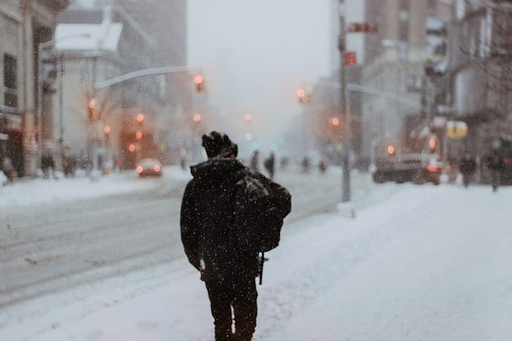
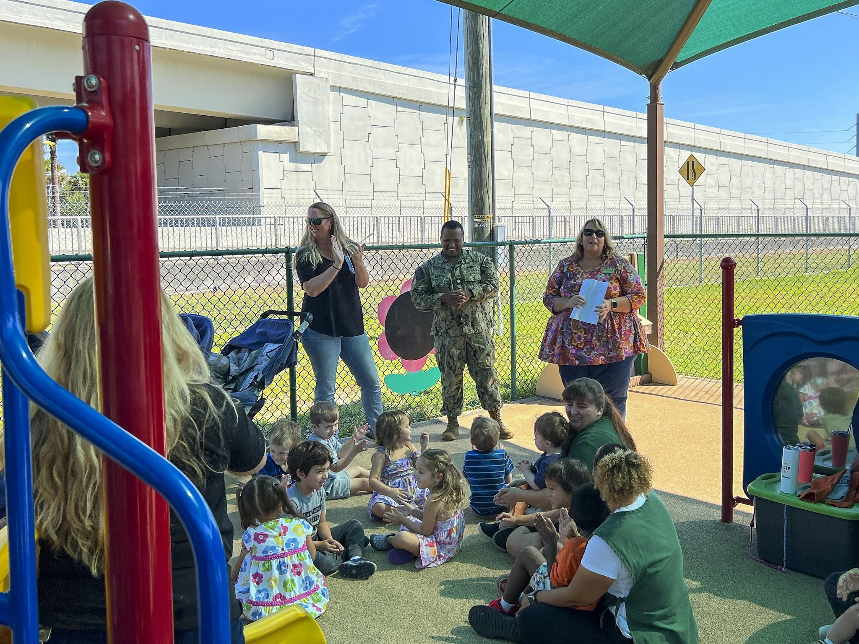
Activity 3: Solving the City problem
How can you make your city warmer during winter?
Where do you go to cool in summer?

Slide 5
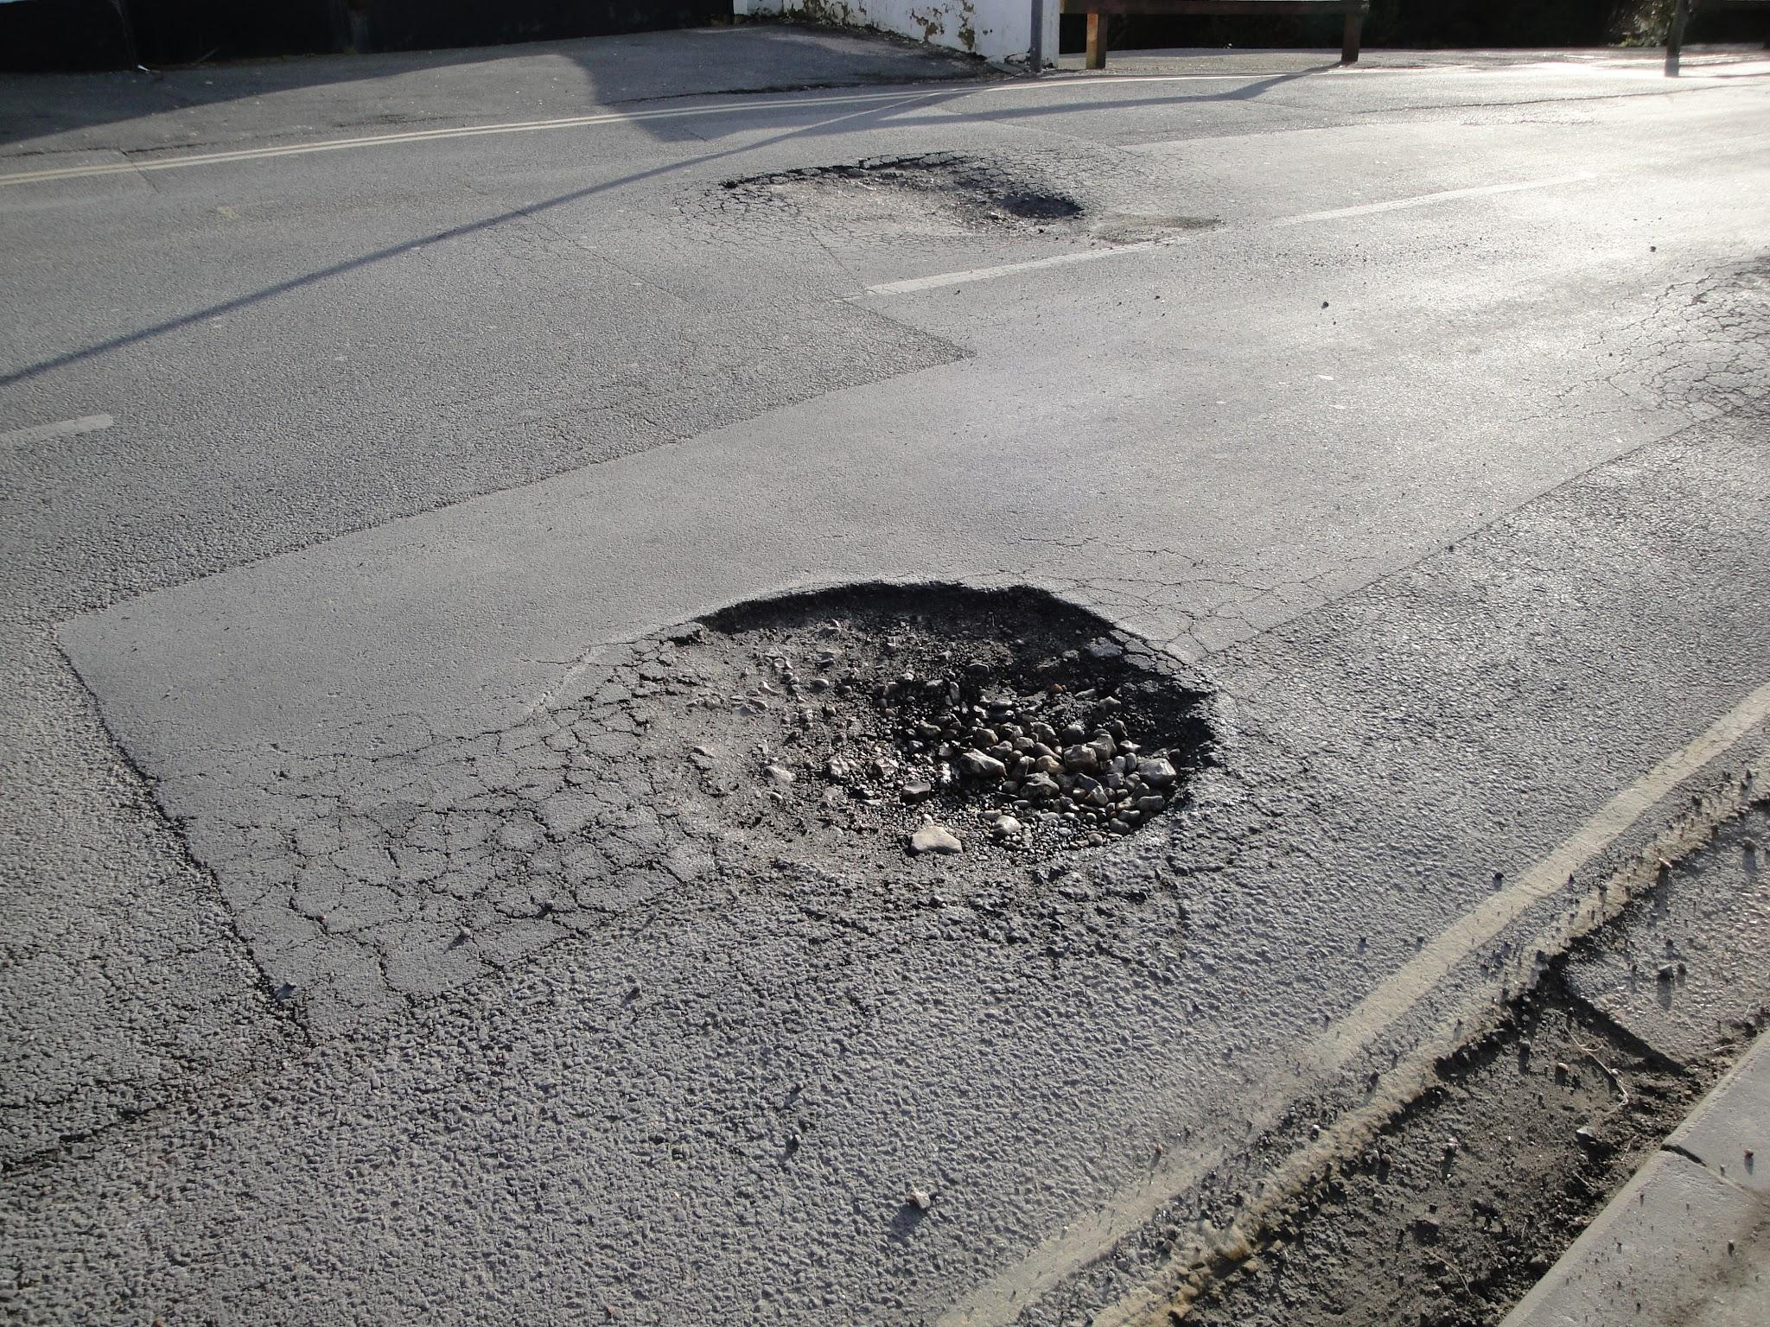
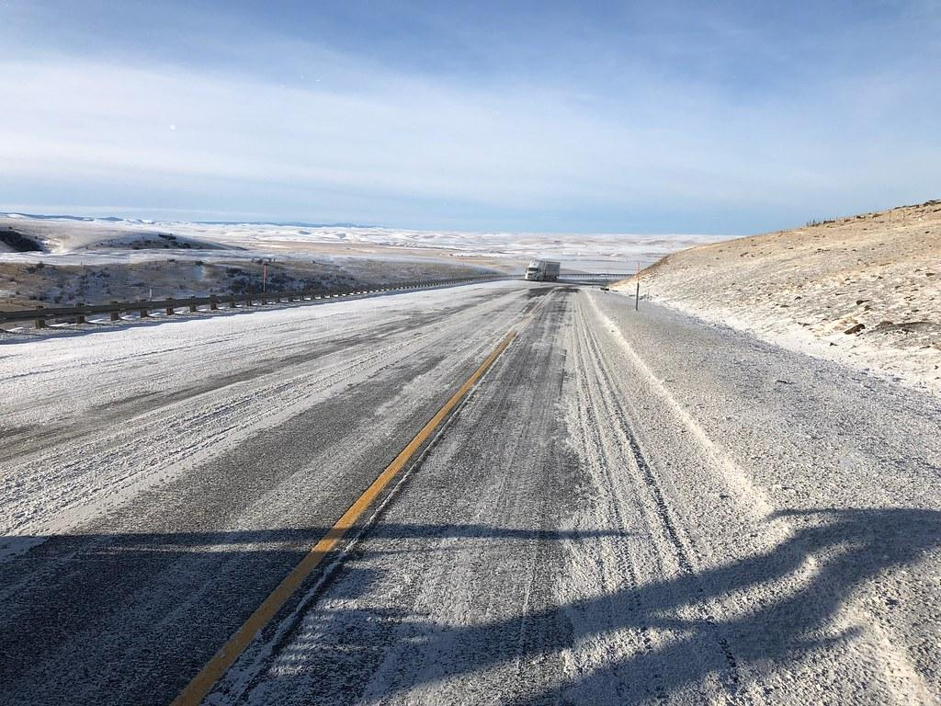
Activity 3: Solving the City problem
Potholes are broken in places in the road. How would you fix a pothole?
During a snowstorm streets become slick because the water in the snow freezes to them. Can you think of a way to make them less slick?

Slide 6
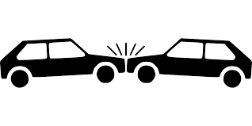
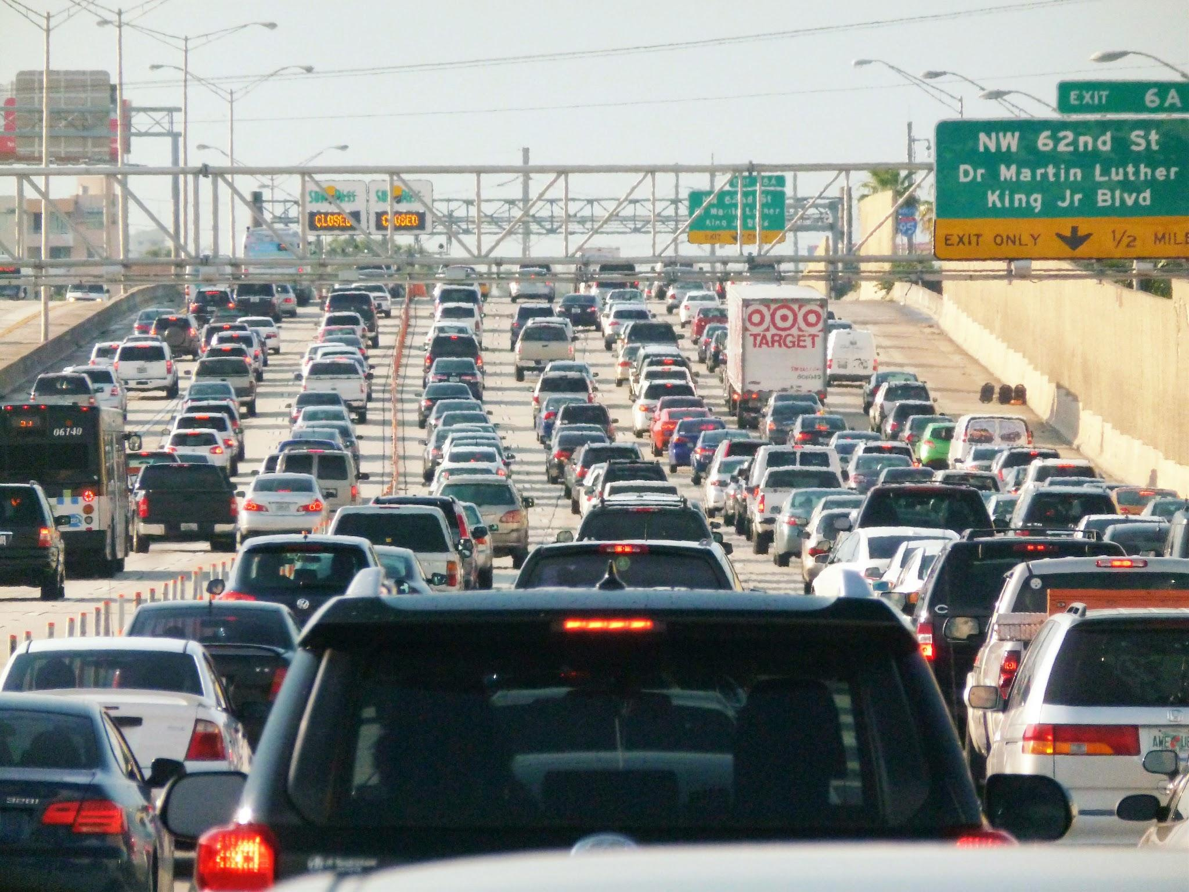
Activity 3: Solving the City problem
If you were a police officer and you saw a car crash, what would you do?
You are a city manager. And you see that there are a lot of cars stuck in the traffic. How would you fix the problem?

Slide 7
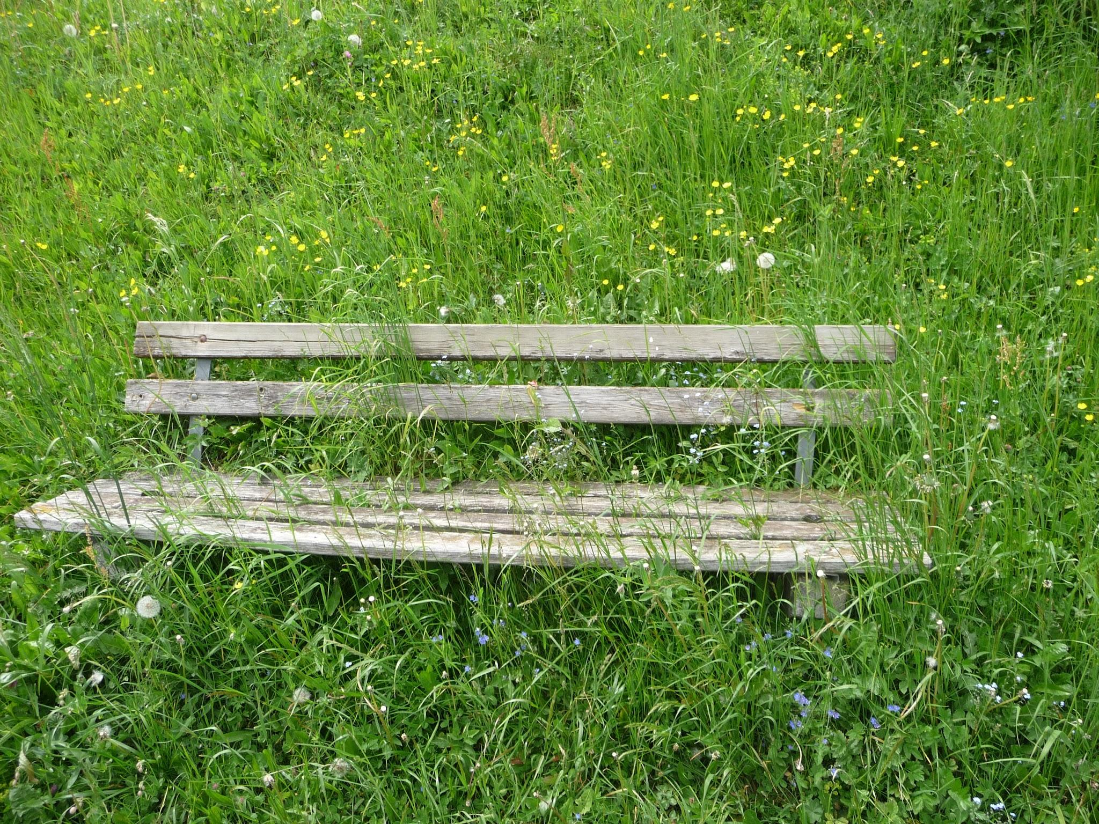
Activity 3: Solving the City problem
A park has overgrown grass and it is becoming unsafe for the people living in your city neighborhood. How would you solve the problem?

Slide 8
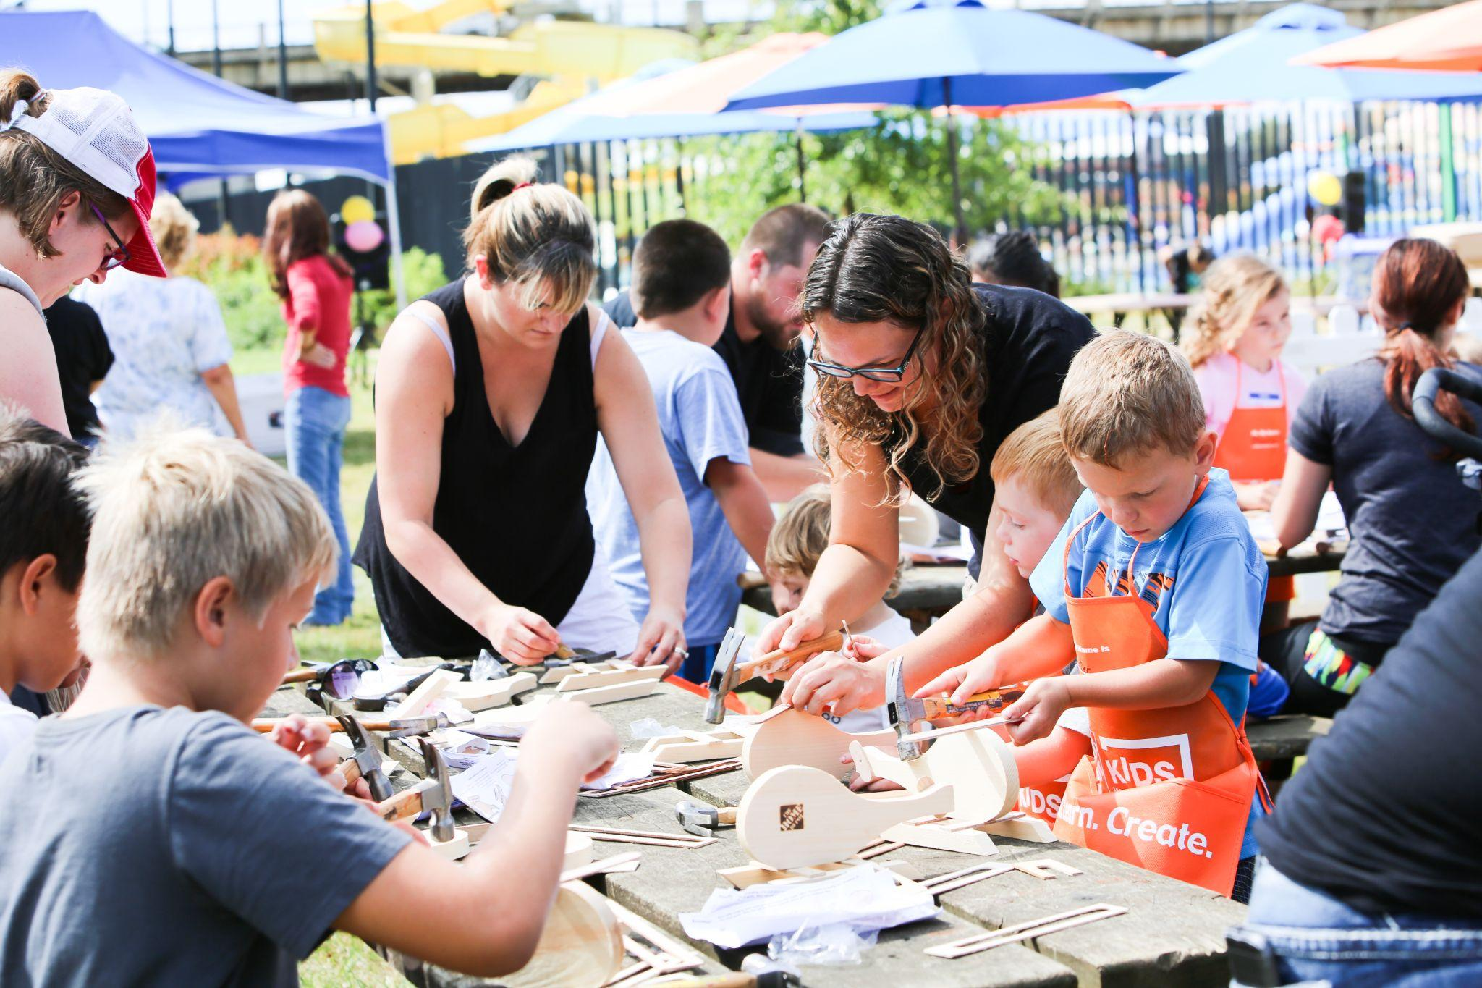
Activity 4; guess the city job
Guess the city job description and what do they do?

Slide 9
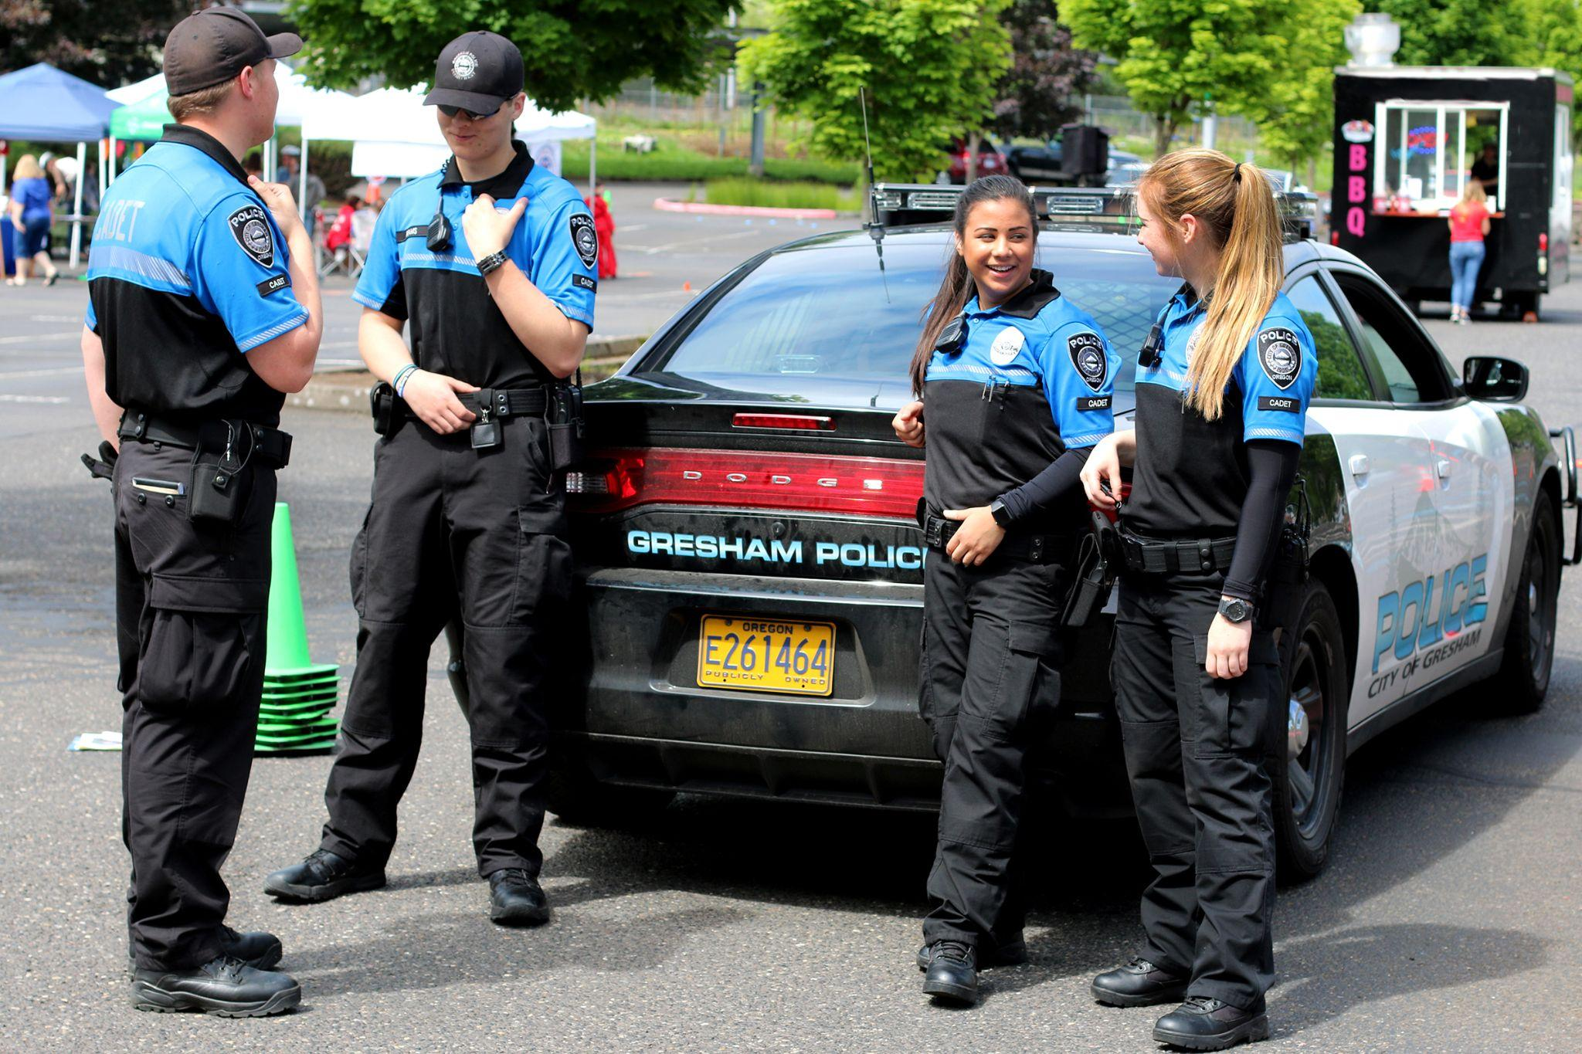
Activity 4; guess the city job
Guess the city job description and what do they do?

Slide 10
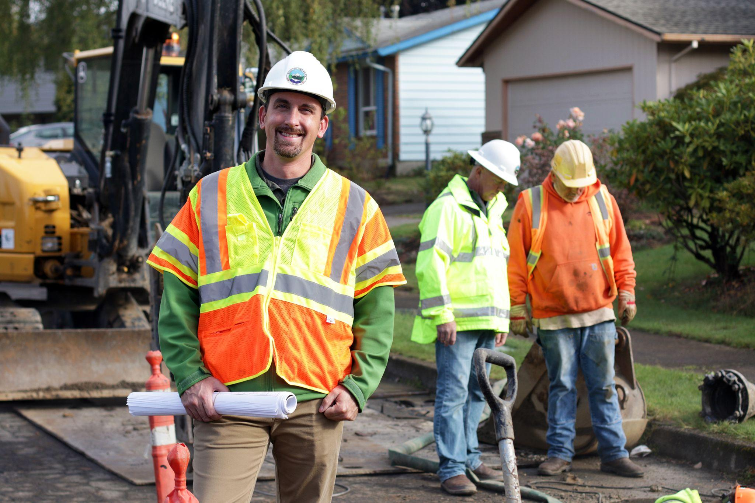
Activity 4; guess the city job
Guess the city job description and what do they do?

Slide 11
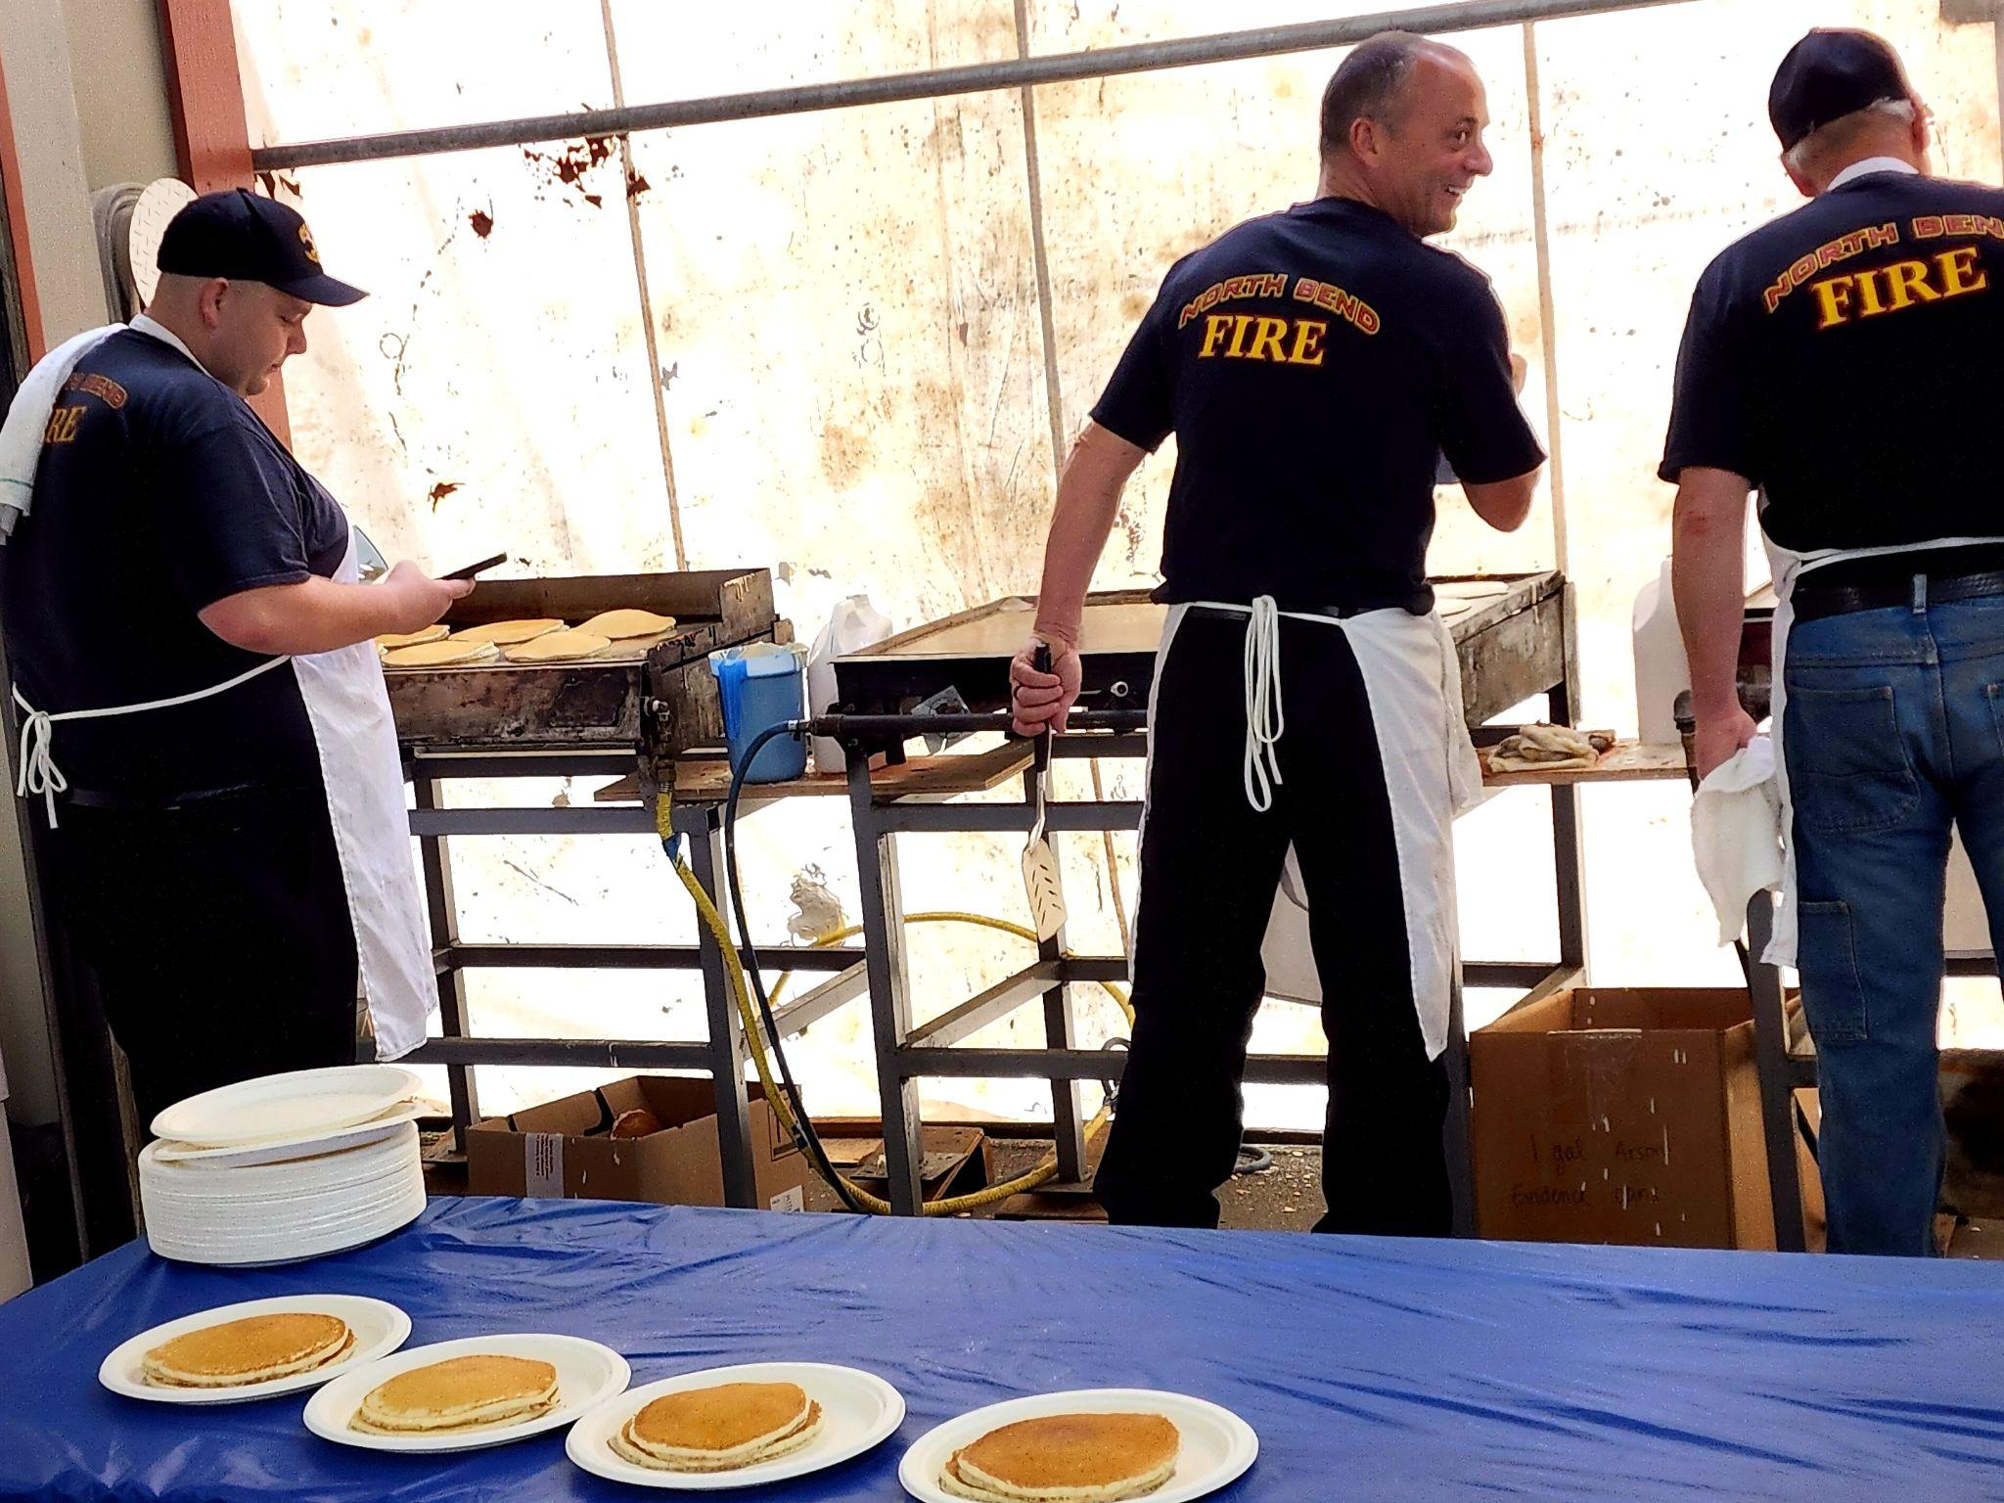
Activity 4; guess the city job
Guess the city job description and what do they do?

Slide 12
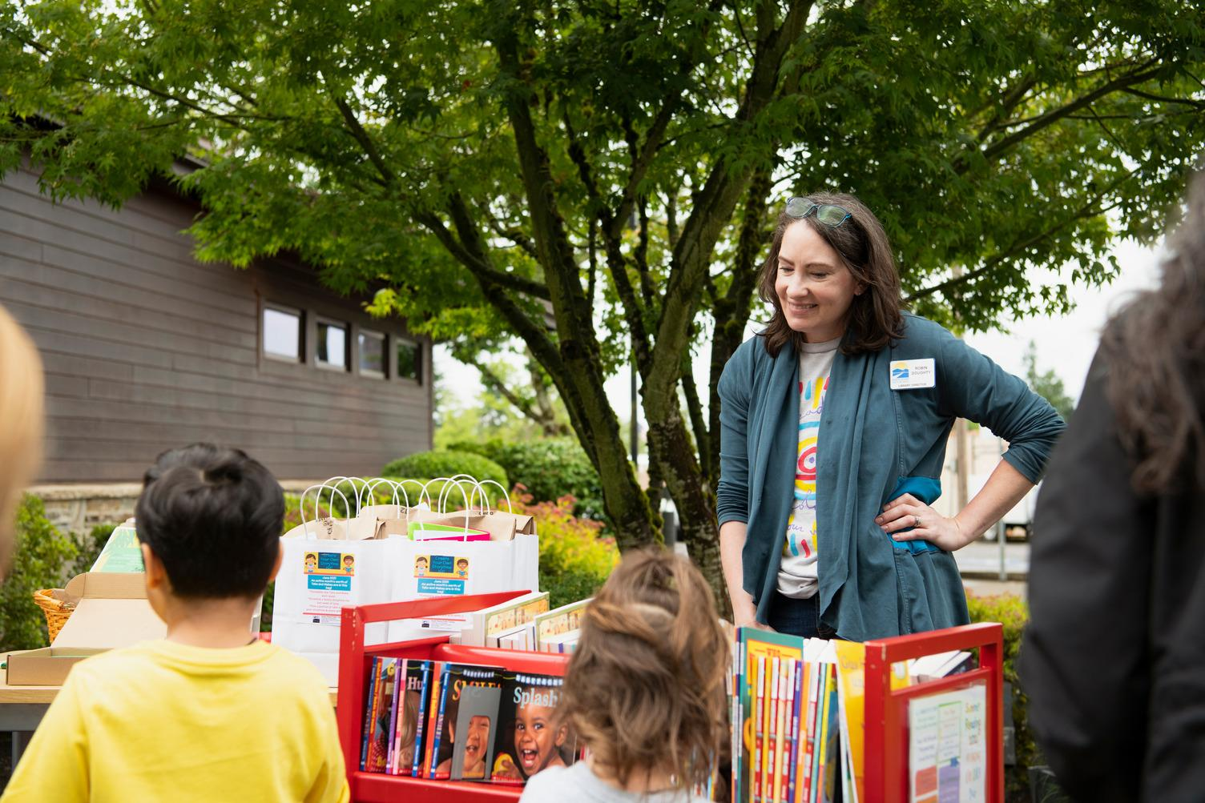
Activity 4; guess the city job
Guess the city job description and what do they do?

Slide 13
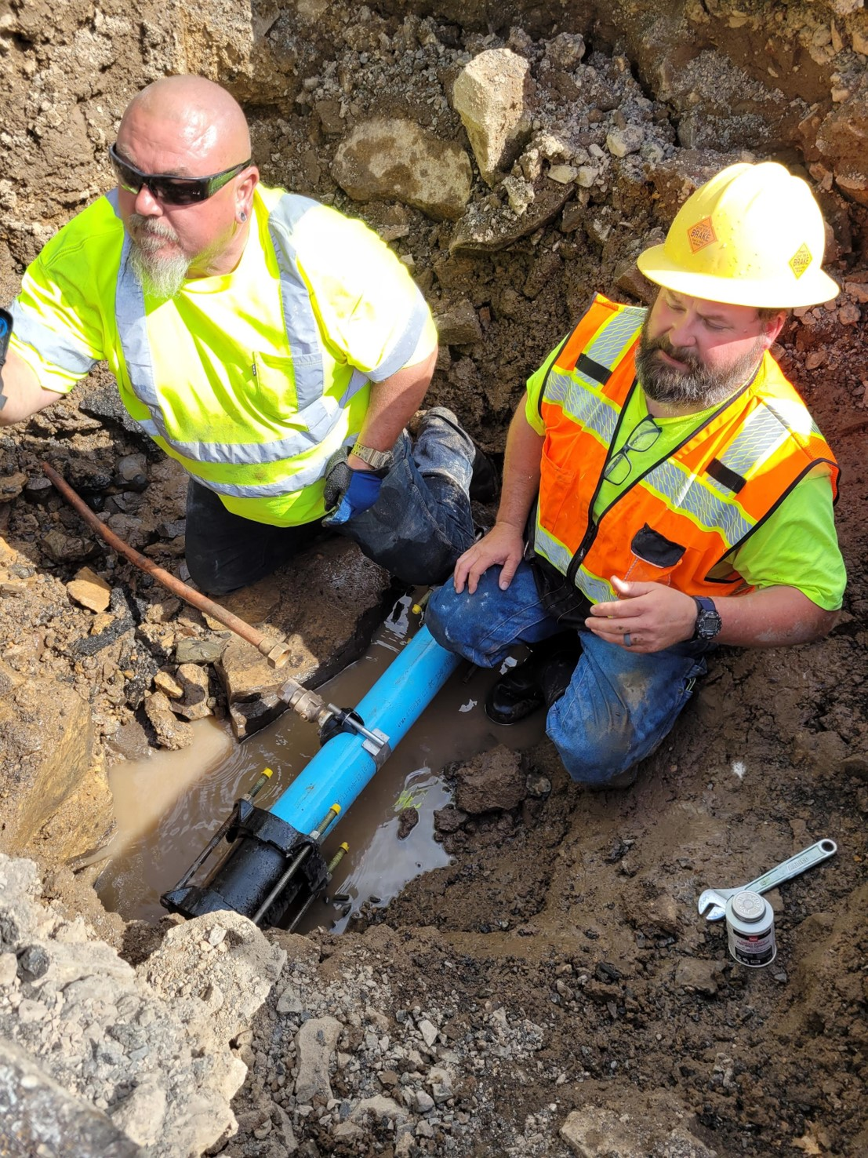
Activity 4; guess the city job
Guess the city job description and what do they do?

Slide 14
Activity 5: Reflection and question
What are some things you learned about local government and what other questions do you have?

